Slide 1
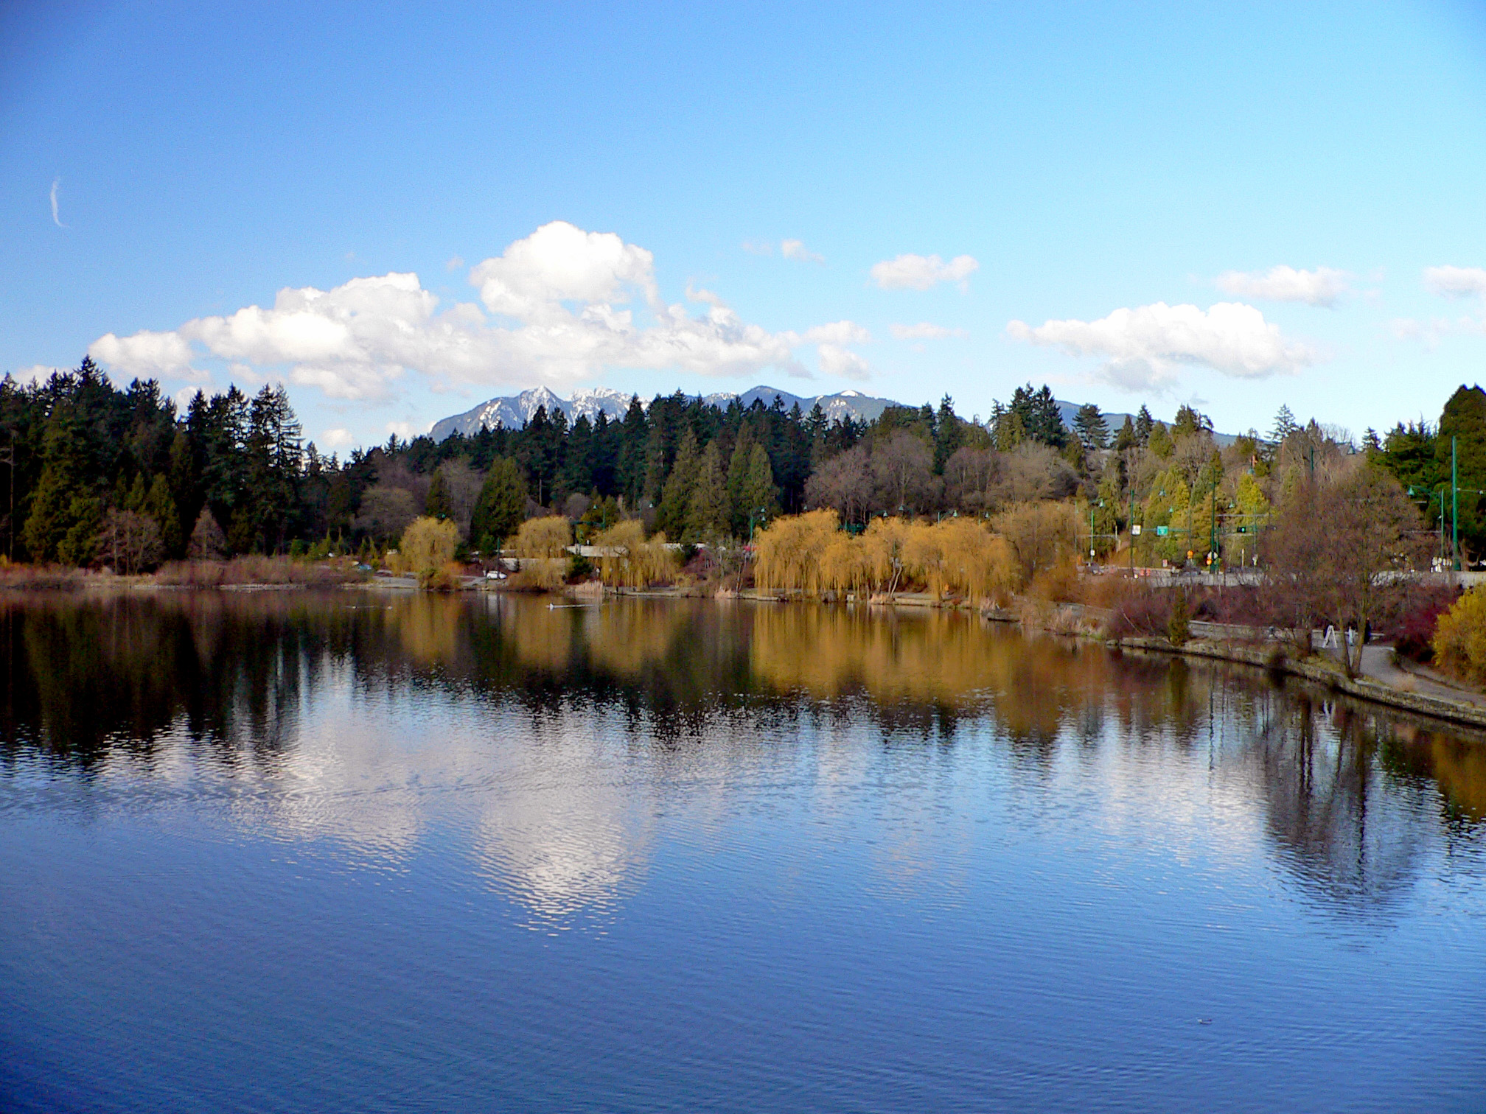
An Analysis of Bird Population Trends in Stanley Park
Paul Chiu
Supervised by Dr. Jill Jankowski
In collaboration with Maria Egerton & Vanessa Smith (Stanley Park Ecology Society)
June 25, 2017
Notes:
Hi! This is an edited & shortened version of my Honours presentation. As it was shortened, a lot of jokes that I had in my Honours presentation have been removed. However, the overall aesthetic of everything improved by quite a bit. Anyways, this best works if you play the slides as is, and if you want an explanation of what I talked about, I have some extra info in the presenter notes.

Slide 2
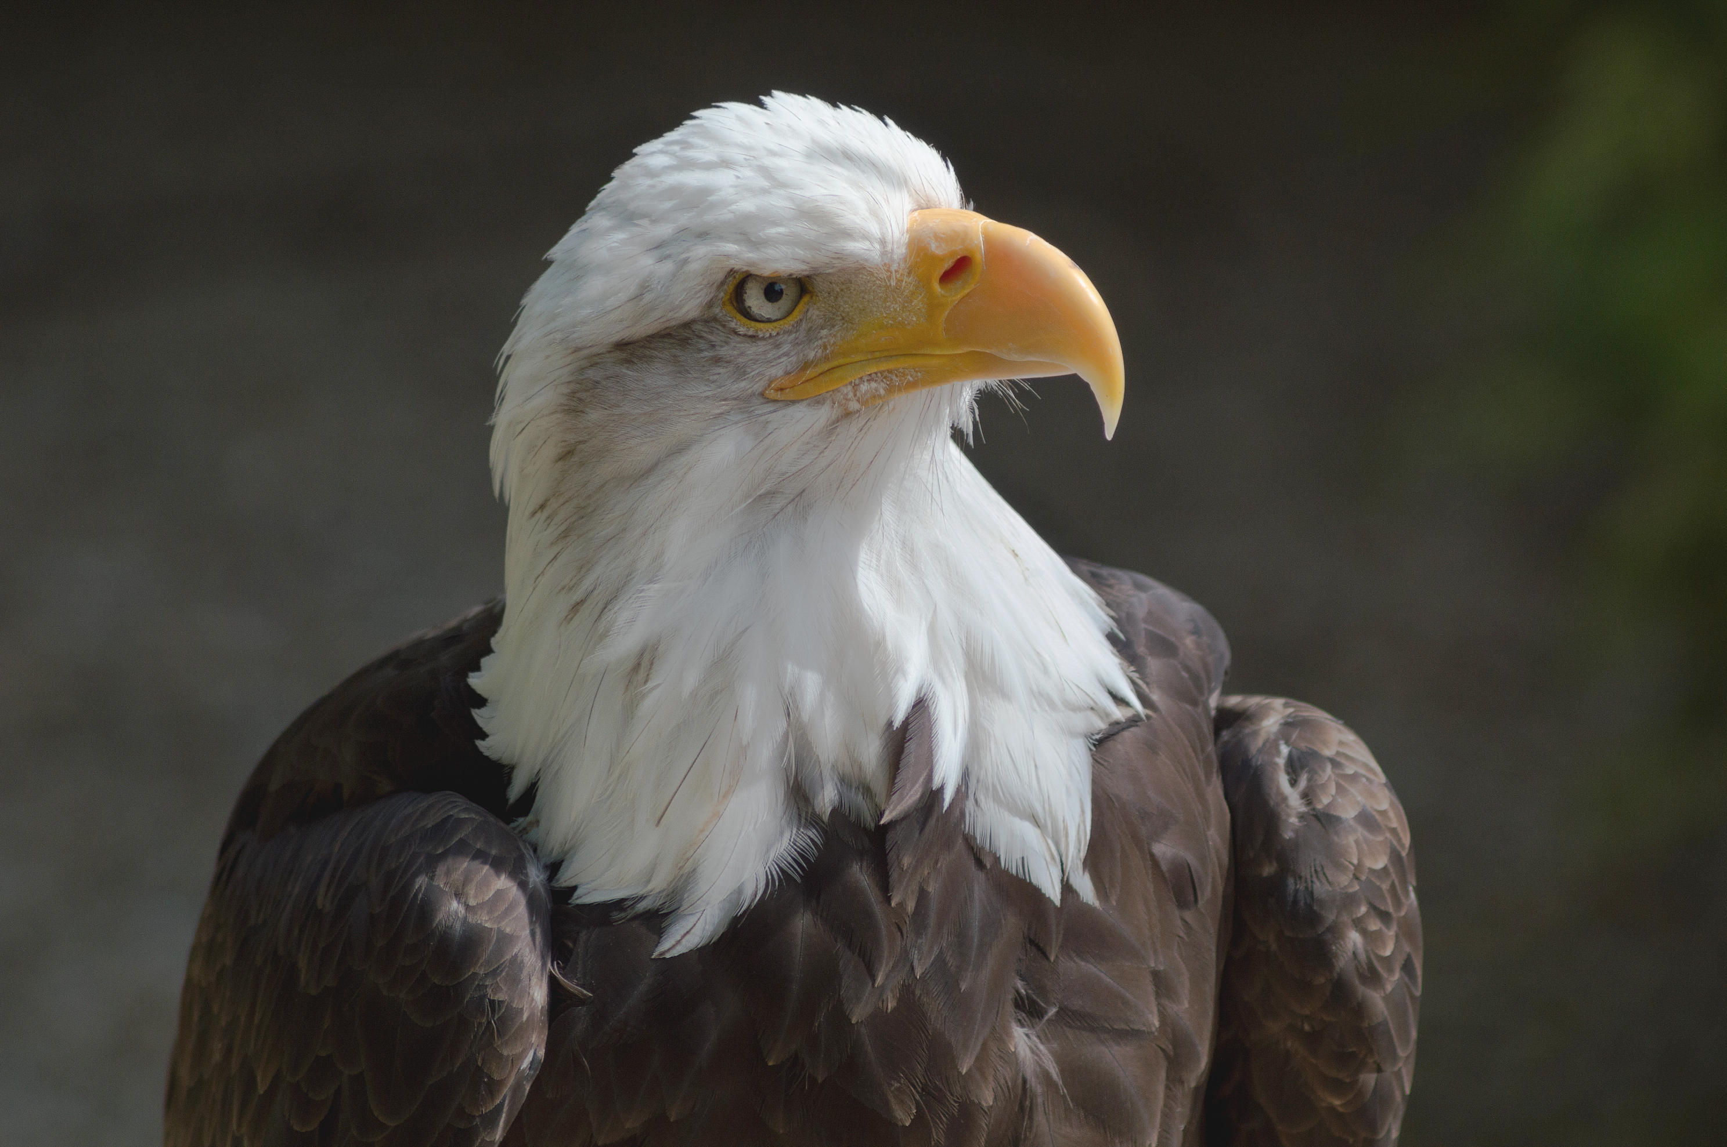
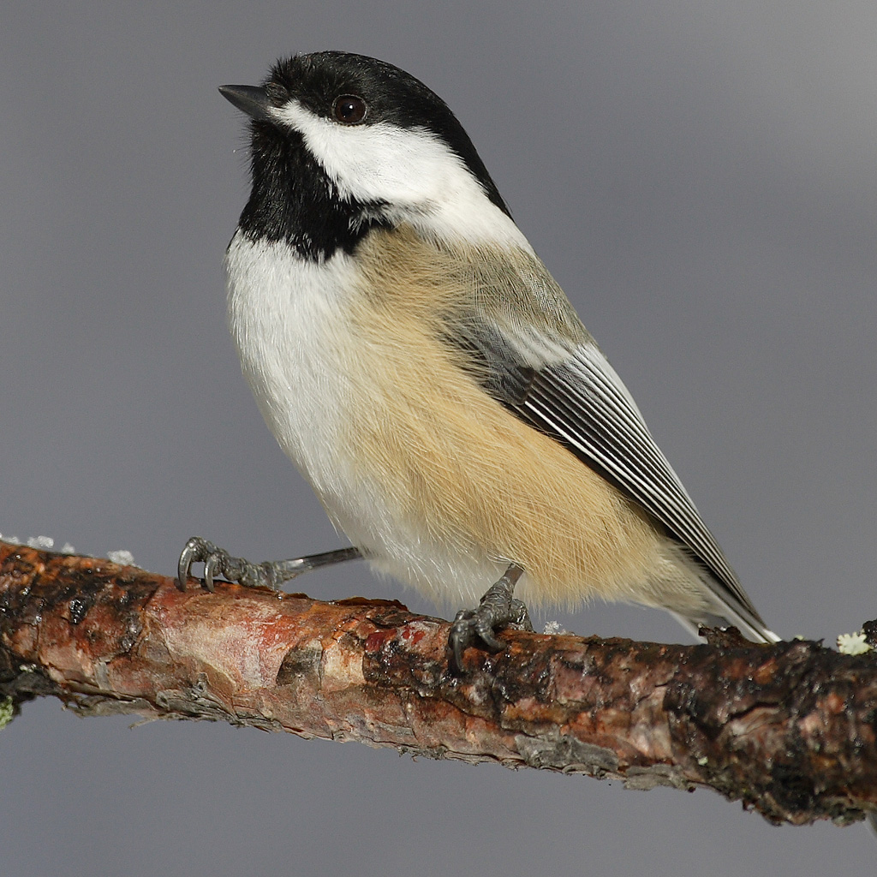
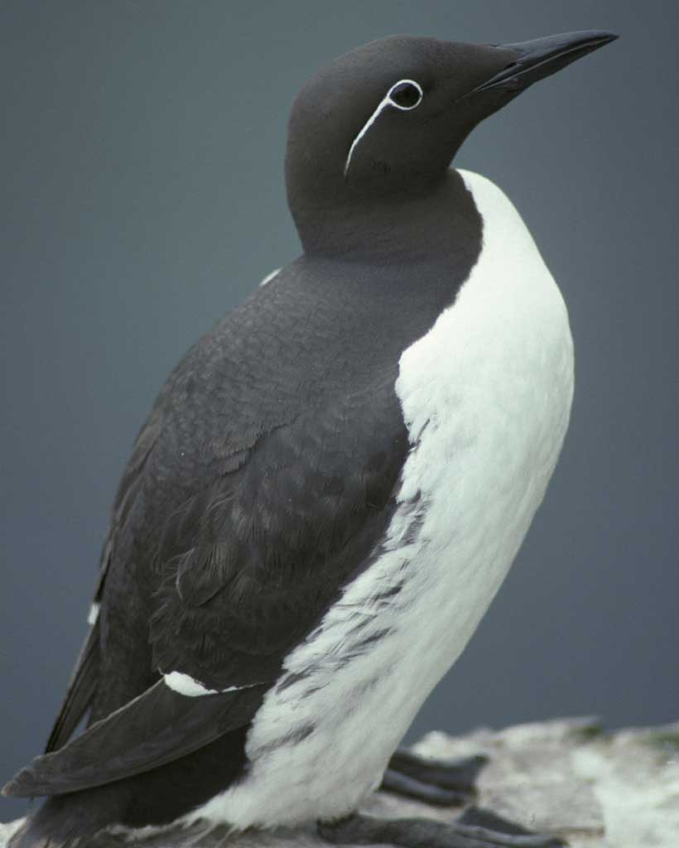
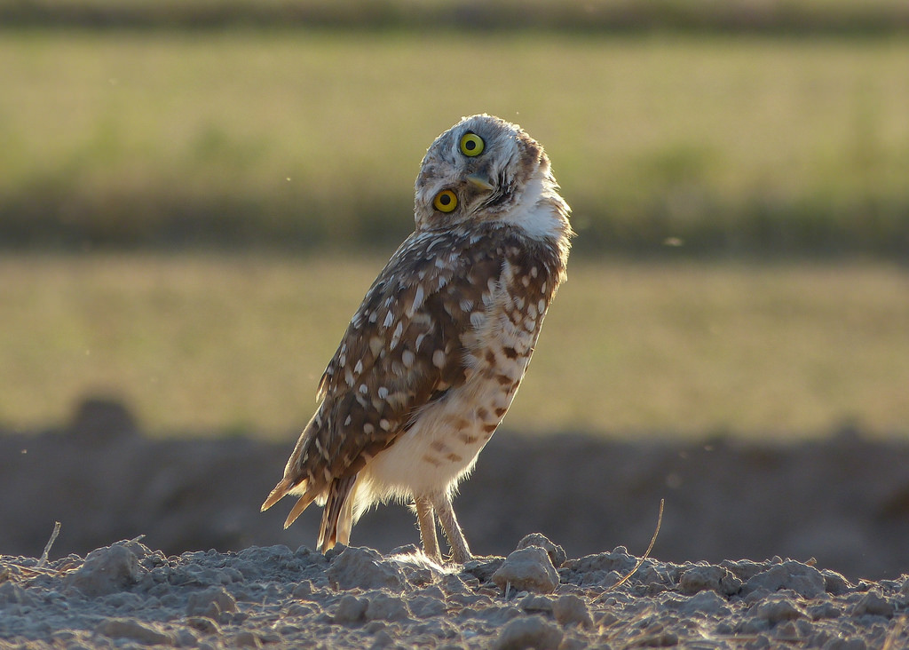
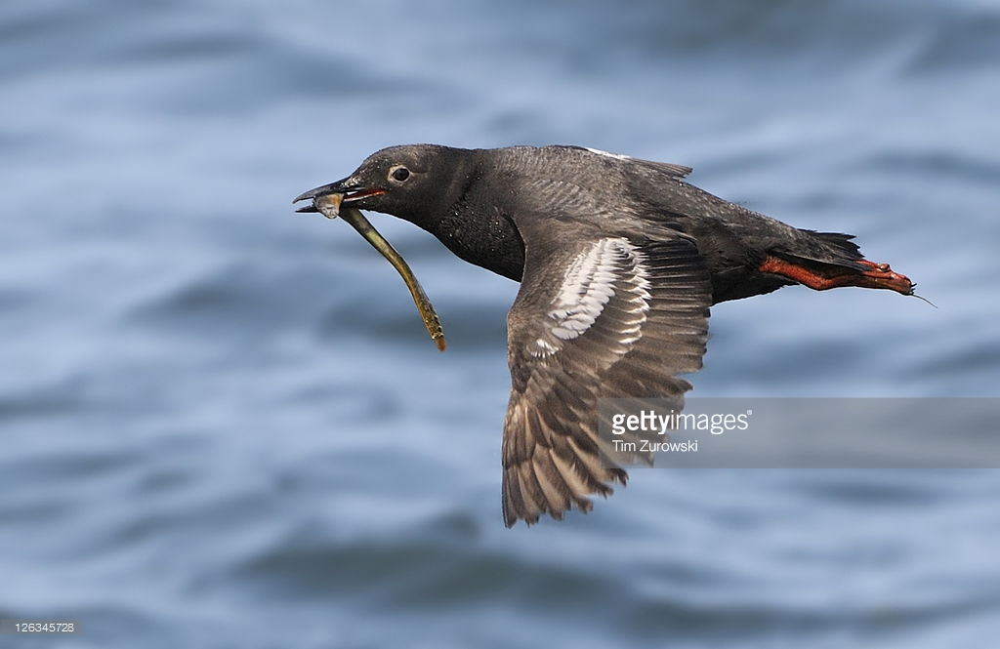
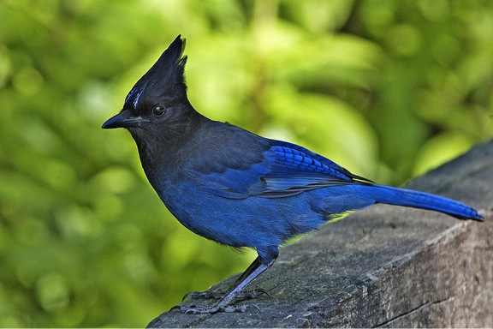
Bald Eagle
Black-Capped Chickadee
Common Murre
British Columbia has a high diversity of birds
Burrowing Owl
Pigeon Guillemot
Stellar’s Jay
Photos (clockwise from eagle): Lewis Hulbert, mdf, Glenn Bartley, Mike’s Birds, Tim Zurowski, Allan D Wilson
Notes:
British Columbia has a lot of different species (maybe like 541 different ones) thanks to habitat heterogeneity (e.g. boreal forests up north, coastal environments on the west side, temperate rainforests, and even deserts)

Slide 3
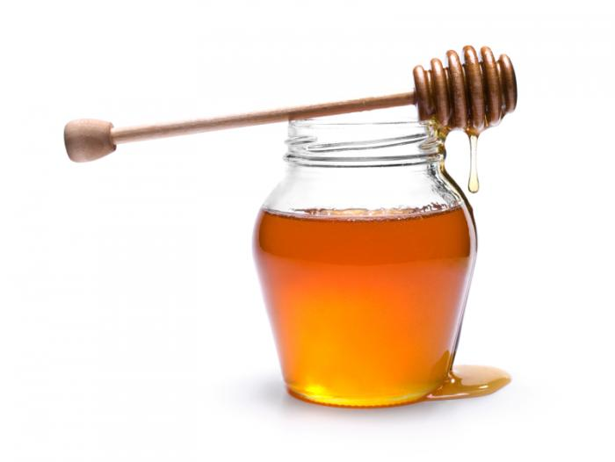
Biodiversity losses have negative ecological effects
Human Activities Pollution
Logging
Overhunting
Ecosytem
Food chain
Energy production
Ecotourism
Biodiversity
(Adapted from Chapin III et al. 2000)
Notes:
Basically, human activities are negatively affecting biodiversity via causing changes in things like land topography. And that by itself causes a lot of effects.
--------------------------
Ecosystem processes (e.g. productivity):
Primary productivity increases with an increase in # of plant species (Tillman 1996) and # of plant species = plant species richness
Removal of sea otters in Near Islands, Alaska => increase in sea urchin population density => overgrazing/destruction of kelp (Estes and Palmisano 1974). and Sea otters = ecological cascade
Temporal stability
Temporal stability of soil water content, population sizes, species richness, gas content. Increase diversity => increase stability (Proulx et al. 2010)
Increase resistance:
Increase diversity => increase resistance (Stachowicz et al. 2002)
Mechanism for this is not well-known. Probably b/c there are are basically no resources for invaders to use.
-experimental assembled communities- positive diversity-resistance relationship. Resistance quantified by survivability of invaders
-Field surveys- relationship was positive. Resistance quantified by number and frequency of non-native invaders
Ecosystem goods and services:
- Like honey production and ecotourism

Slide 4

Tracking biodiversity in parks is important
Parks…
can sustain species (Fernández-Juricic et al. 2001) => biodiversity
Solves a problem: Humans living in an urban setting are exposed to fewer birds than average (Melles 2005)
allow interactions with nature => more likely to positively perceive natural environments (Bixler et al. 2002)
provide experiences with high avian biodiversity => appreciation of nature (Clergeau et al. 2001)
Park management tracks species populations
=> can determine needed conservation efforts
=> prevent negative ecological & sociological effects
Notes:
When I say “Parks can sustain species” I don’t mean all of them can b/c it depends on other factors like size and the makeup of buildings all around it.

Slide 5
Photo: Craig Nagy
Notes:
If you’re wondering what a good example of an urban park would be, here’s Stanley Park.

Slide 6
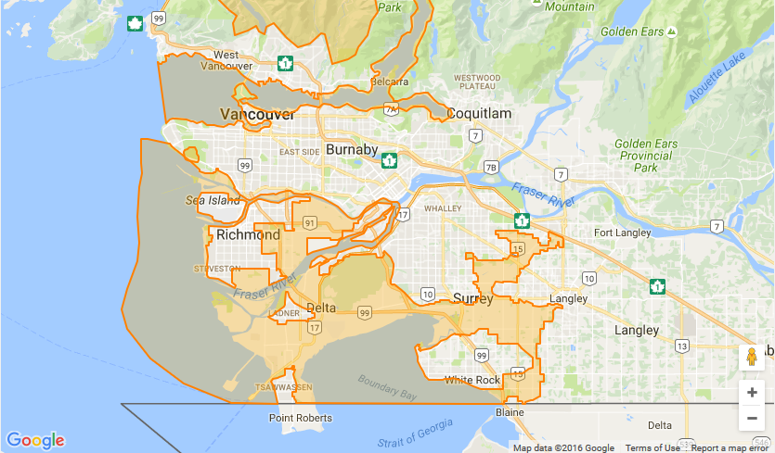
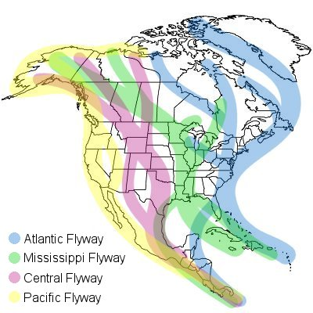
Stanley Park has a high avian biodiversity
It’s an Important Bird Area.
230+ avian species can be seen throughout the year.
Notes:
Greater Vancouver Watershed, English Bay + Burrard Inlet, & Fraser River Estuary are all IBAs according to BirdLife International.
Pacific Flyway, a route stretching from the Alaskan Arctic to the southernmost tip of South America that is taken by millions of migratory birds each year
Also East Atlantic, Mediterranean, West Asian-East African, Central Asia, East Asian-Australian, West Pacific. 10 flyways in total (check out extra slides)

Slide 7
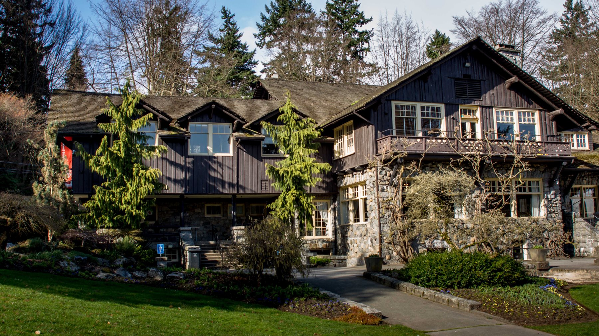

Photo: Stanley Park Ecology Society
Notes:
Stanley Park also has the Dining Pavillion => SPES

Slide 8
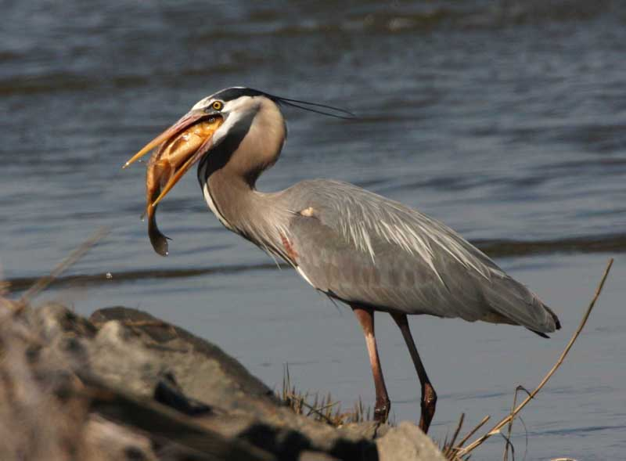
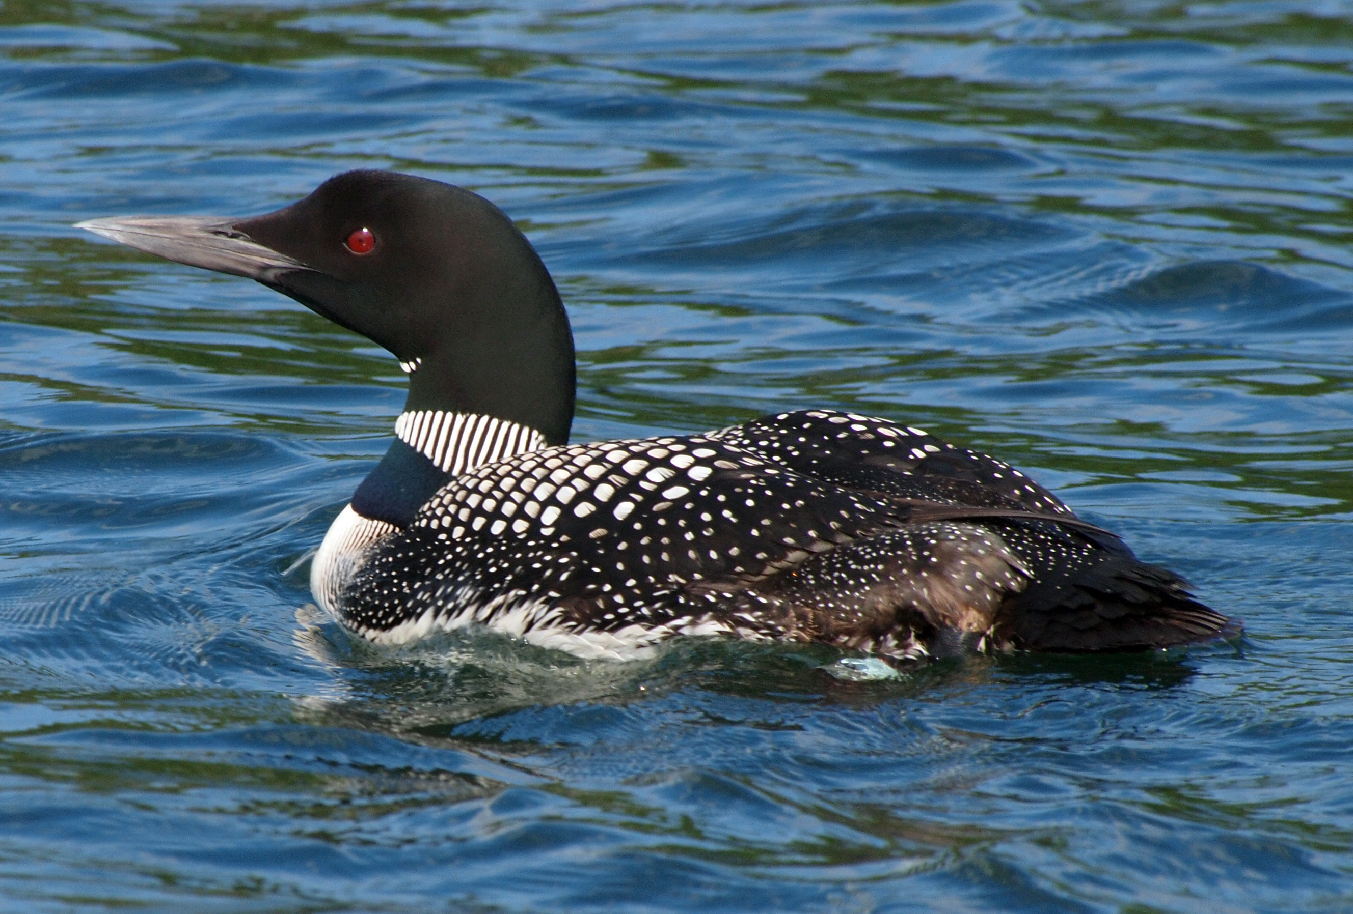
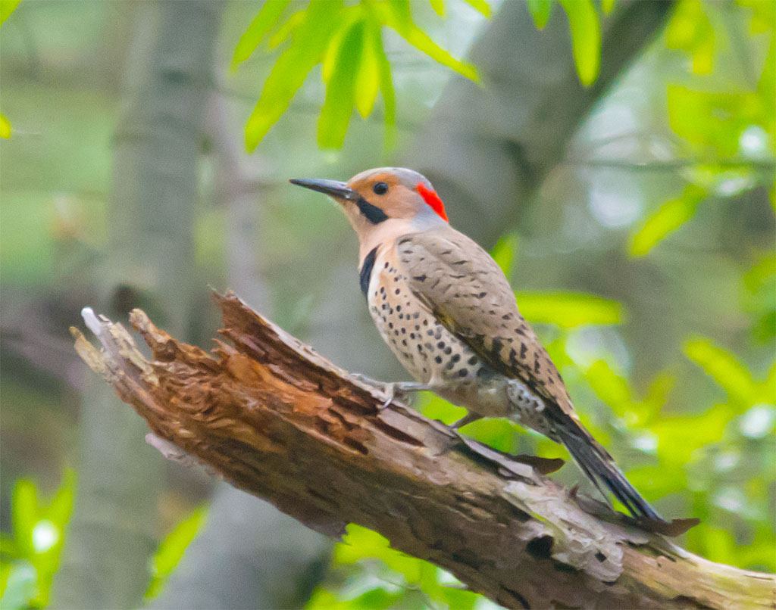
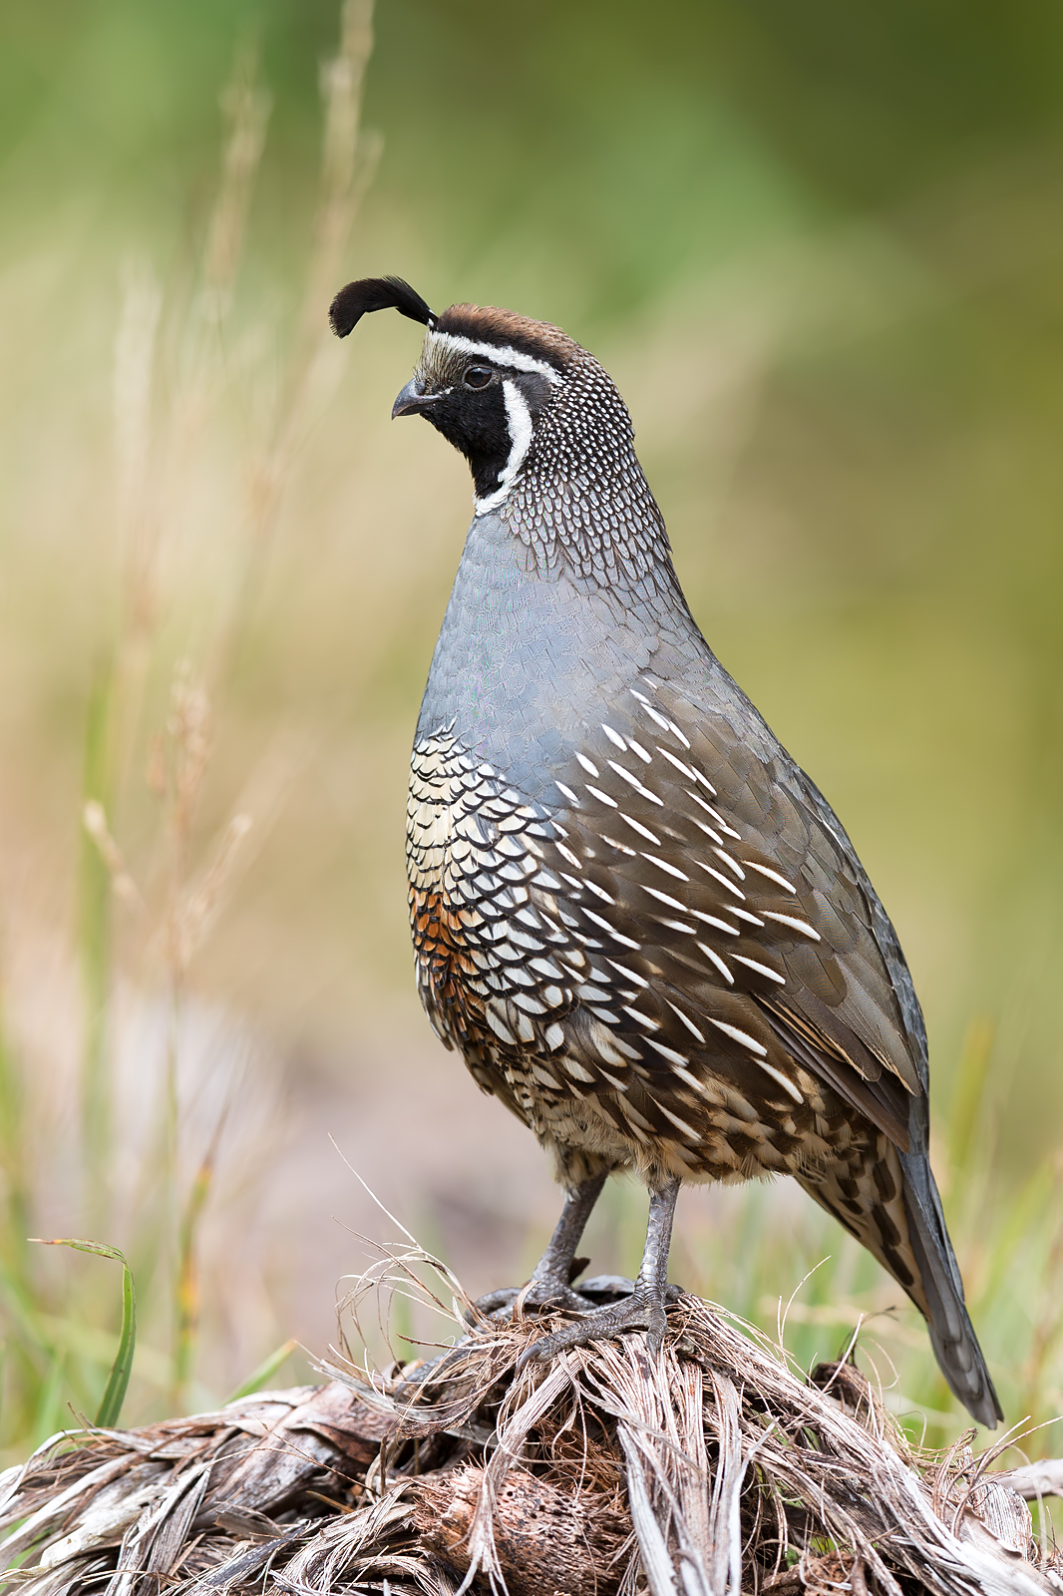
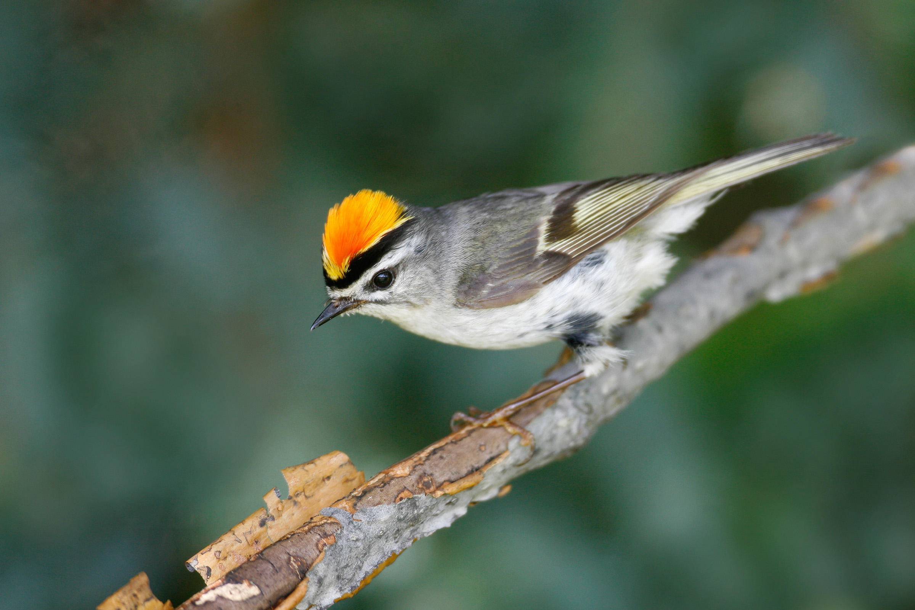
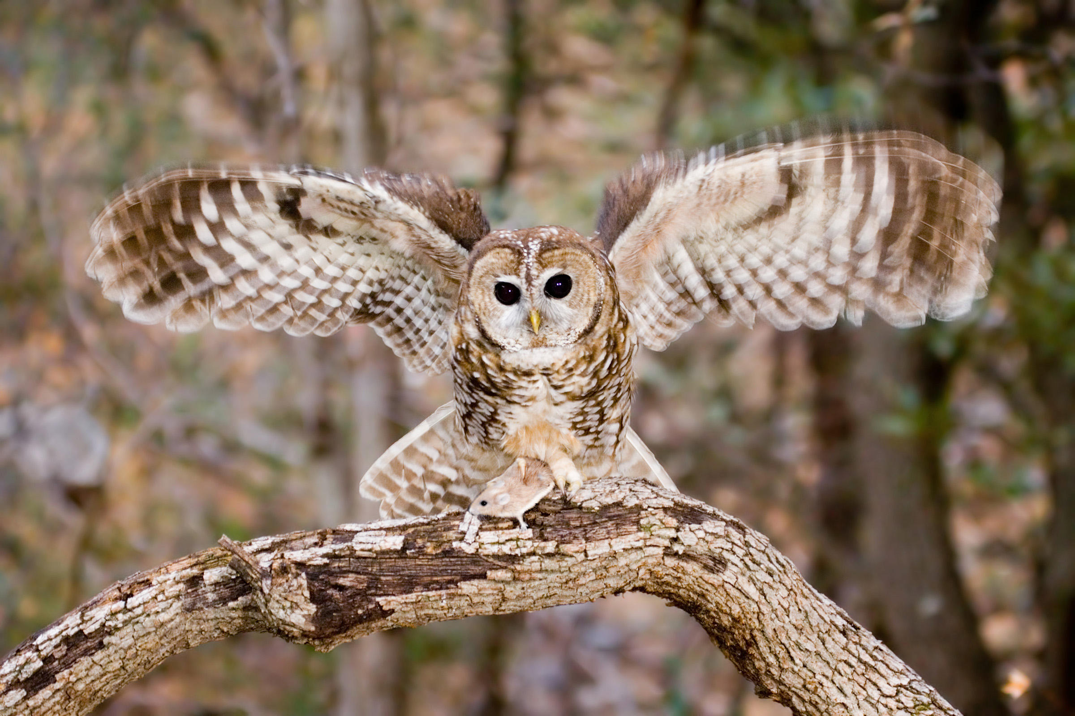
Great Blue Heron
Common Loon
Northern Flicker
Have there been any changes in the various observed bird populations over time in Stanley Park?
Golden-Crowned Kinglet
Spotted Owl
California Quail
Photos (clockwise from GB heron): Frank Miles, John Picken, Hugh Vandervoort, Brian E Small, Rick & Nora Bowers, Arindam Bhattacharya
Notes:
I collaborated w/ the SPES in order to answer this question.
To get more specific in this, you’ll need some more background (check Worcester 2011, heh)

Slide 9
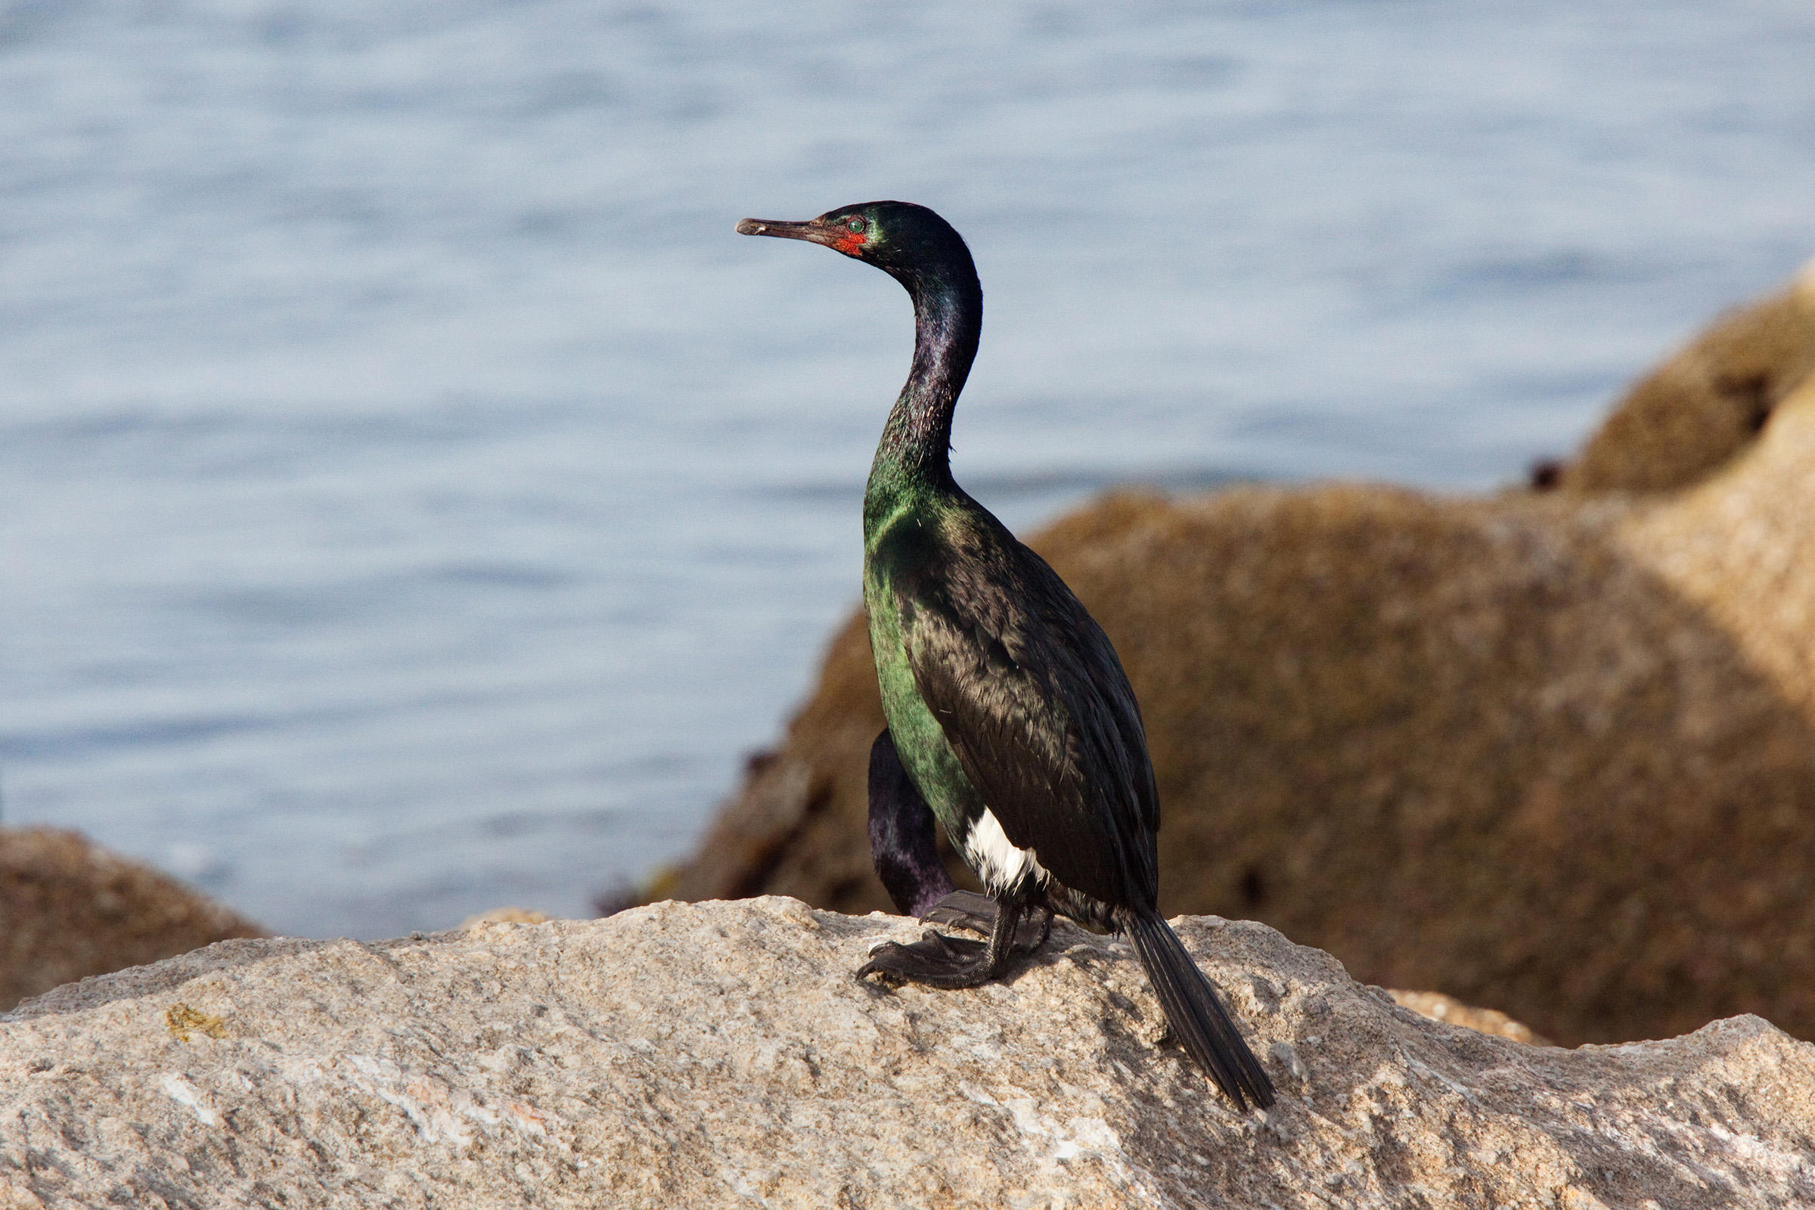
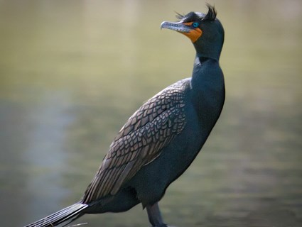
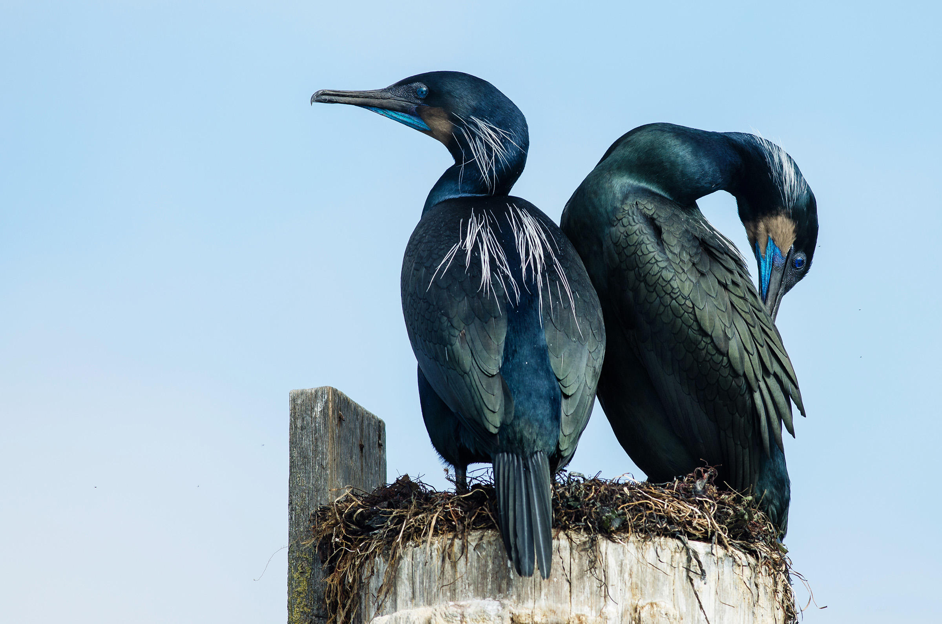
A previous SPES study found…
Decline in fish-eating diving bird species
Threats: industrial pollution, overfishing, habitat degradation, urban encroachment, climate change, disturbance from humans + off-leash dogs, watercraft in intertidal areas
Increase in cormorants
<= habituation to humans
Pelagic
PC: Nick + Nora Bowers
Double-Crested
PC: Laura Meyers
Brandt’s
PC: Jan Arendtsz
Prediction: Increase in population + urbanization => more disturbances => biodiversity changes
Notes:
So basically, SPES + BCIT people have been doing bird surveys along the Seawall for a while now. Worcester (2011) compared data collected between 2001 and 2002 to data collected between 2010 and 2011.
TWO DIFFERENT PERIODS OF TIME.
-------------------------------------------
Disturbances can mess up the resting and feeding periods for these fish-eaters.
Cormorants increase in abundance b/c they’re habituated to disturbances. For reference, Canada geese also experienced an increase in abundance.

Slide 10
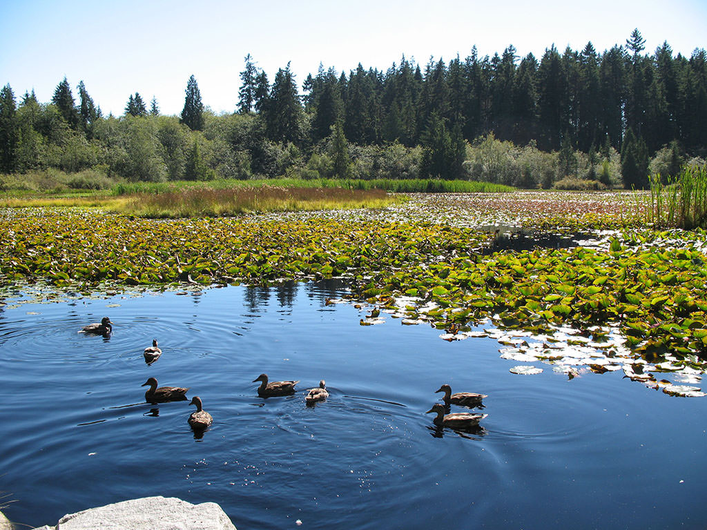
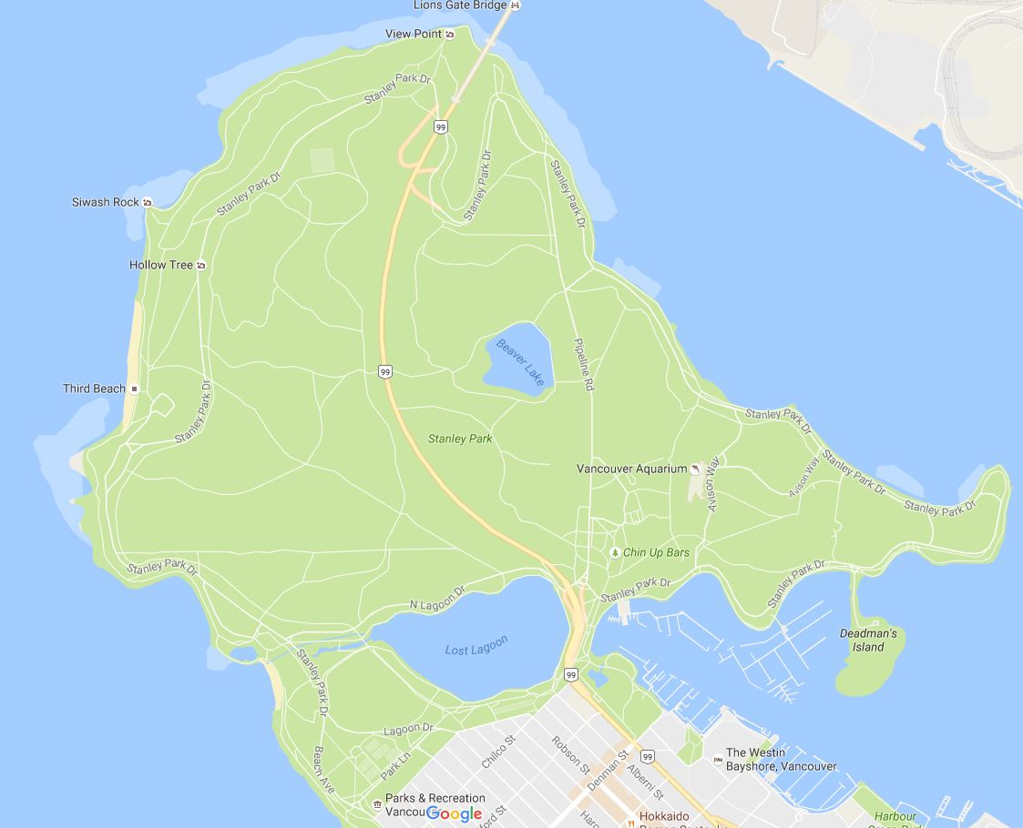
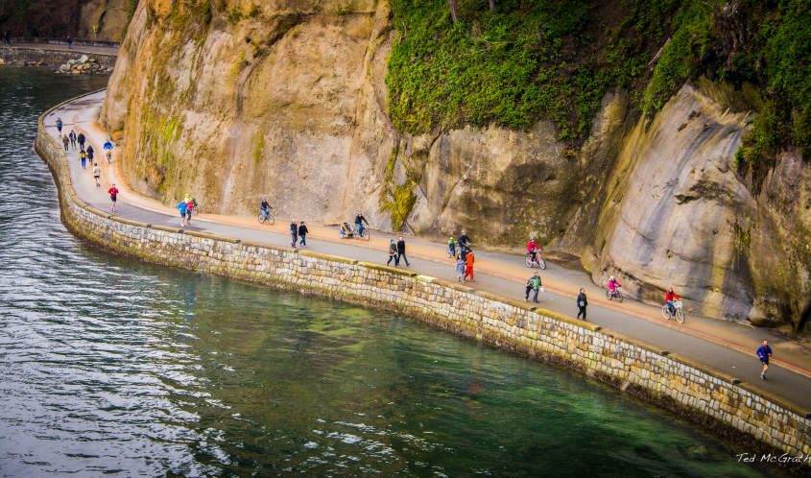
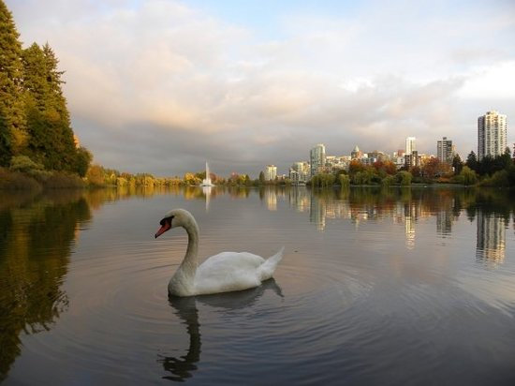
Photo: Vancouver Trails
Photo: Ted McGrath
Photo: Tripadvisor
Notes:
Four data sets from four data sites:
Beaver Lake + Lost Lagoon: collected monthly between 2005 and 2016 (although I was given some 2001 & 2002 data for Beaver Lake too)
Devonian Harbour Park: collected monthly (or at a higher frequency) between 2010 and 2014.
The Seawall/Winter Waterbirds: collected yearly on the third Sunday of each November. Data is from 2005 to 2015, but there’s data from 2001.

Slide 11
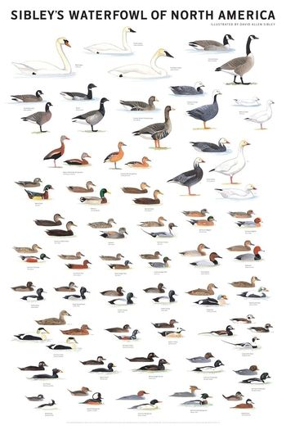
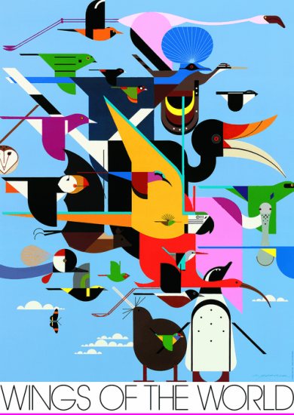
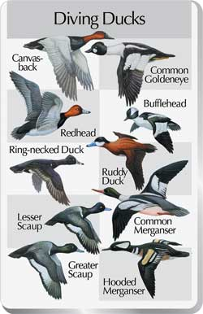
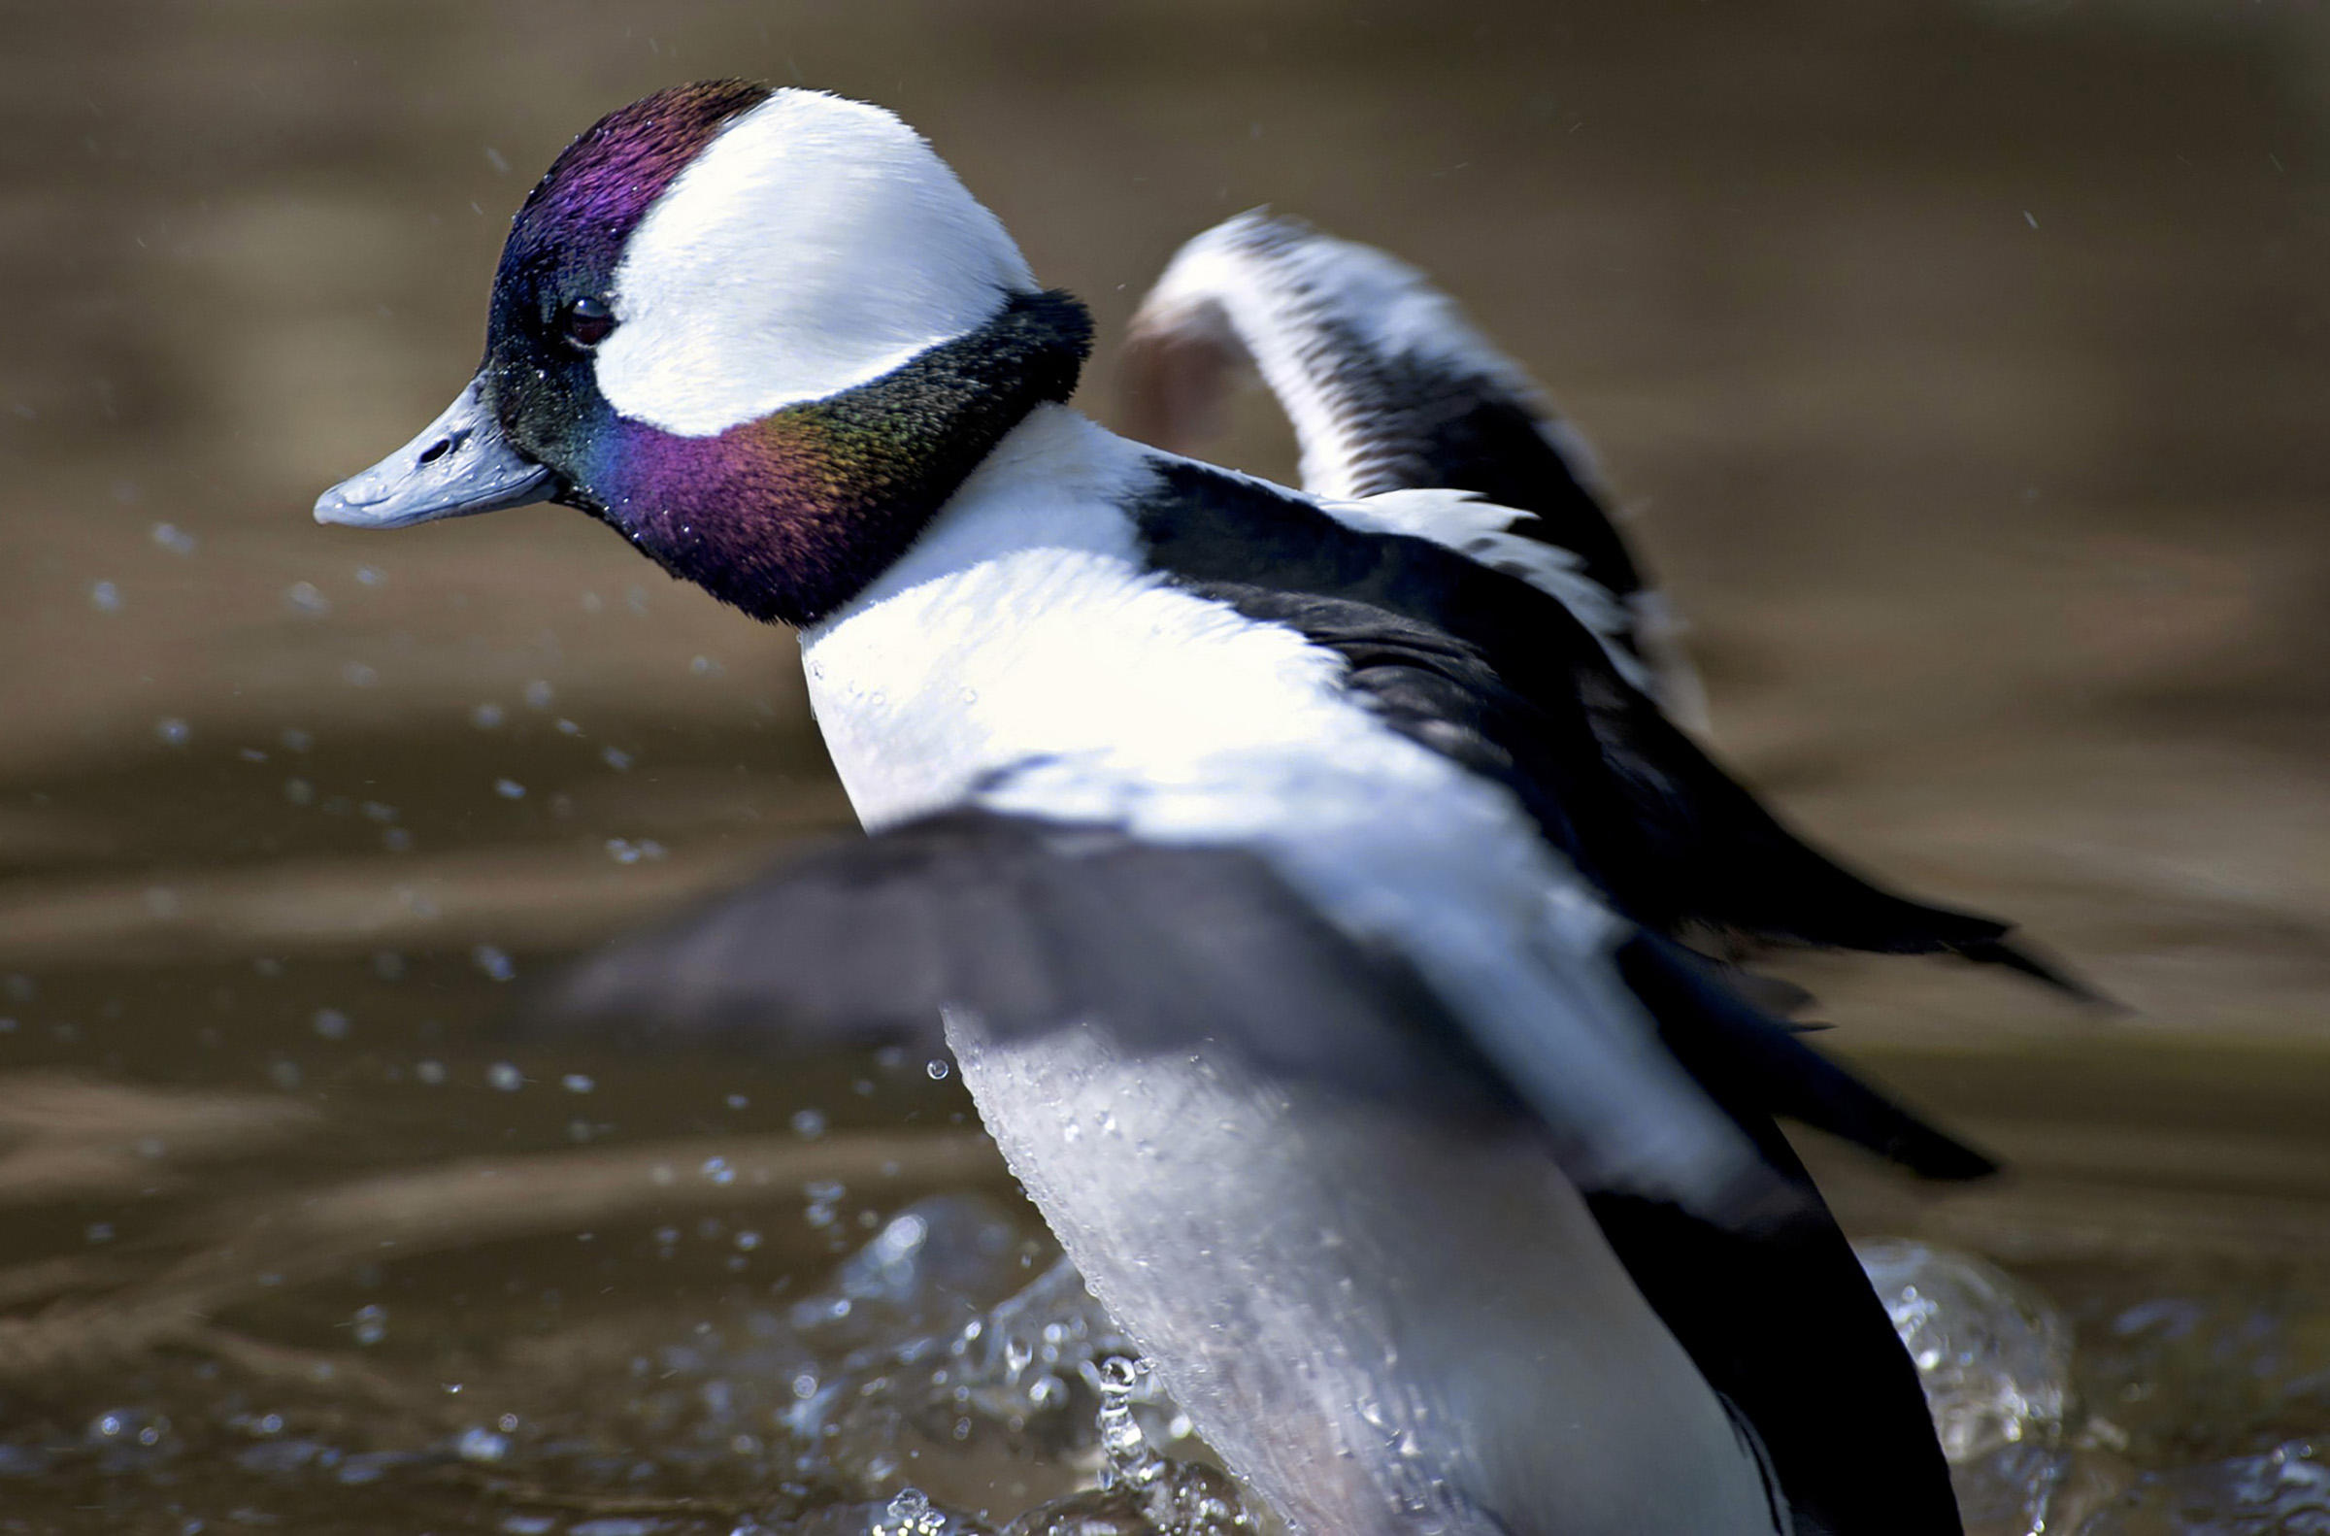
Methods
Analyses were performed on four tiers
First tier: All birds in general
Second tier: Seven main taxonomic groups
Third tier: Split the seven main groups
Fourth tier: Each individual species
Bufflehead
Photo: Ray Morris
By Charley Harper
Notes:
First tier: abundance, richness, and diversity (via Simpson’s Index of Diversity) were analyzed
Second tier: Seven groups that Jill and I felt were pretty good representations of the park’s species; looked at abundance and richness
Third tier: Split up the seven groups; looked at abundance and richness
Fourth tier: Individual species; abundance only
Check out the summary spreadsheet for more details.

Slide 12

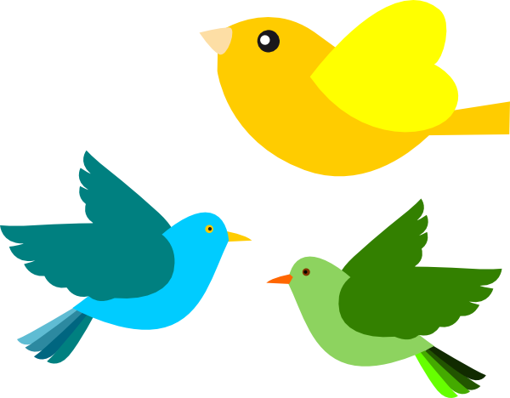

Abundance
+
Richness
Abundance
Richness
Diversity
Notes:
The three measures of biodiversity I looked at.

Slide 13
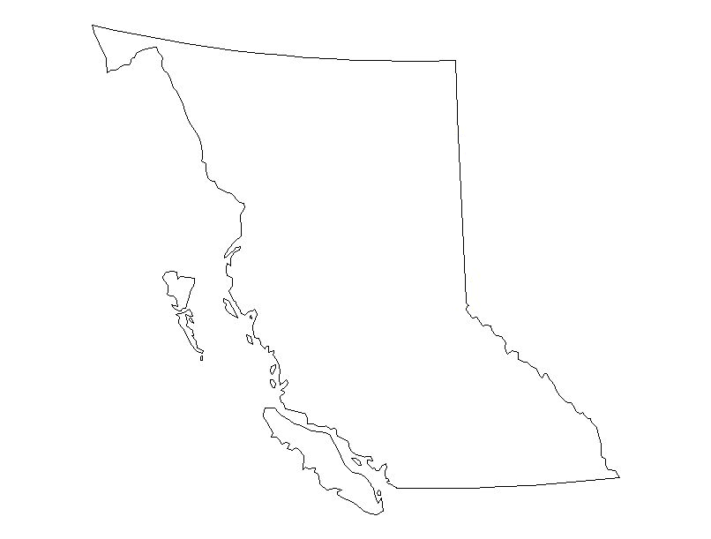

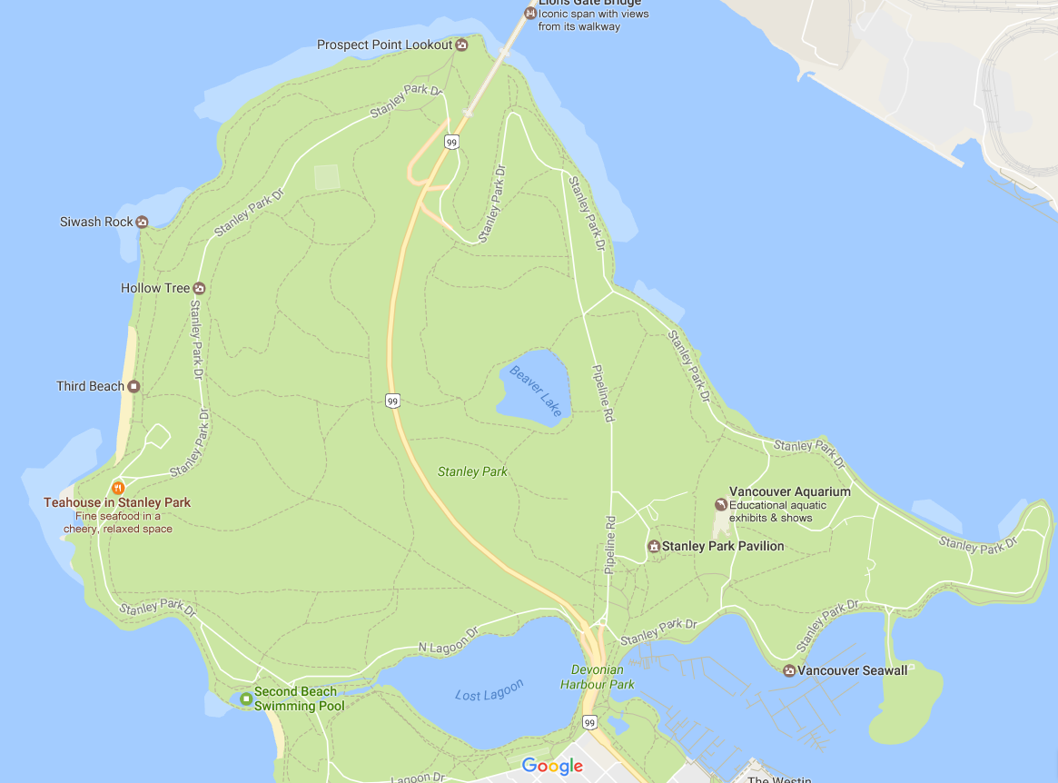

~10000–20000 species
~200 families
26-40 orders
542 species
~65 families
22 orders
236 species
150 species
39 families
16 orders
Notes:
The # of species, families, and orders in three different tiers (World, BC, Stanley Park [according to SoP and me])
Why 150 species? Check back to the issues w/ methodology.

Slide 14
2001 2002 2003 2004 2005 2006 2007 2008 2009 2010 2011 2012 2013 2014 2015 2016
Notes:
Linear regression (LR) says significant increase. I say increase
Feb 2010: PINE SISKIN
1 = Jan 2001. 2 = Feb 2001. 12 = Dec 2001.

Slide 15
Jan Feb Mar Apr May Jun Jul Aug Sep Oct Nov Dec

Slide 16
2005 2006 2007 2008 2009 2010 2011 2012 2013 2014 2015 2016 2017
Notes:
LR says insignificant increase. I say stable.
March 2005: LESC

Slide 17
Jan Feb Mar Apr May Jun Jul Aug Sep Oct Nov Dec
Notes:
Feb 2008: Less MALL than usual
March 2013: More RECR, more PISI, A LOT MORE LESC THAN USUAL
July 2015: More MALL, more BARS (LIKE 70 WOW), more CAGO than usual, more SOSP than usual
Oct – Dec 2016: less BCCH, less CAGO, less GCKI, less MALL, less NOCR

Slide 18
2001 2002 2003 2004 2005 2006 2007 2008 2009 2010 2011 2012 2013 2014 2015 2016
Notes:
LR says significant increase. I say increase.

Slide 19
2005 2006 2007 2008 2009 2010 2011 2012 2013 2014 2015 2016
Notes:
LR says significant increase. I say increase

Slide 20
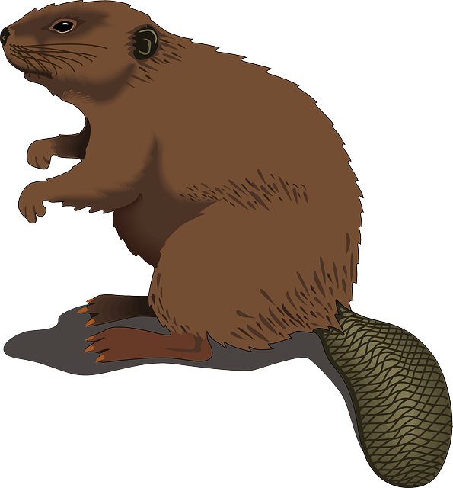

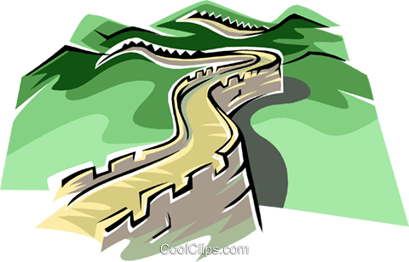
Study Site | Beaver Lake | Lost Lagoon | The Seawall
Abundance | Increasing | Stable | N/A
Richness | Increasing | Increasing | N/A
Diversity | No temporal trend (N/A) | No temporal trend | N/A

Slide 21
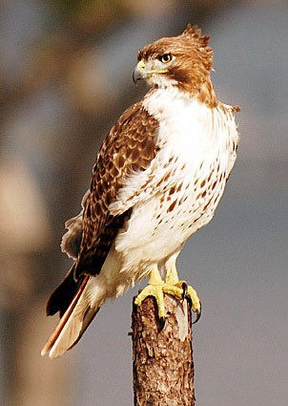
Raptors
Study Site | Beaver Lake | Lost Lagoon | The Seawall
Abundance | Stable | Stable | Stable
Richness | Stable | Stable | Stable
Red-tailed Hawk
Photo: Steve Neitzel

Slide 22
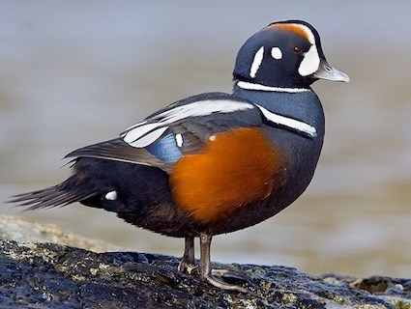
Ducks, Swans, and Geese
Study Site | Beaver Lake | Lost Lagoon | The Seawall
Abundance | Increasing | Decreasing | No temporal trend
Richness | Stable | No temporal trend | Decreasing
Harlequin Duck
Photo: Glenn Bartley

Slide 23
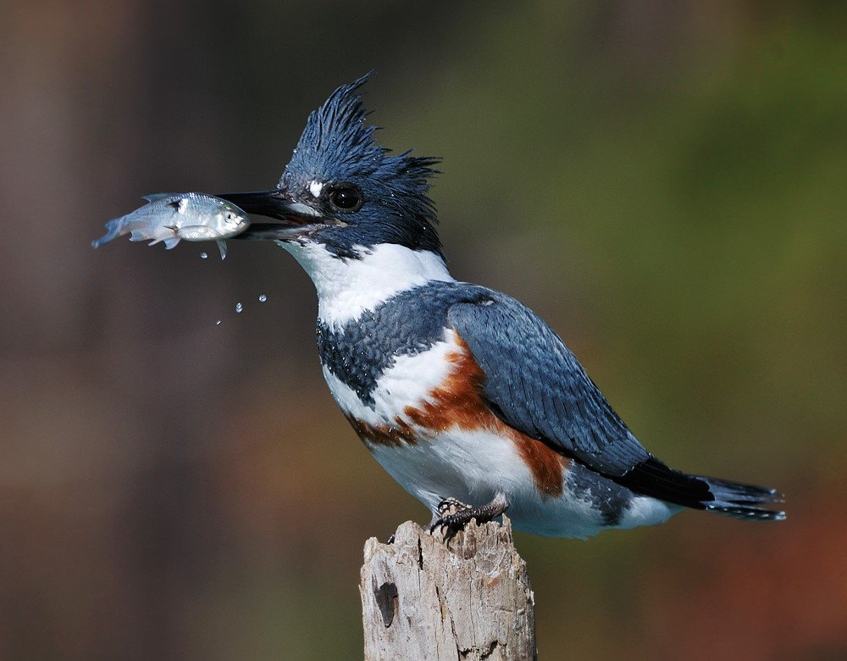
Other Waterbirds
Study Site | Beaver Lake | Lost Lagoon | The Seawall
Abundance | Stable | Decreasing | No temporal trend
Richness | Stable | Stable | Increasing
Belted Kingfisher
Photo: unknown

Slide 24
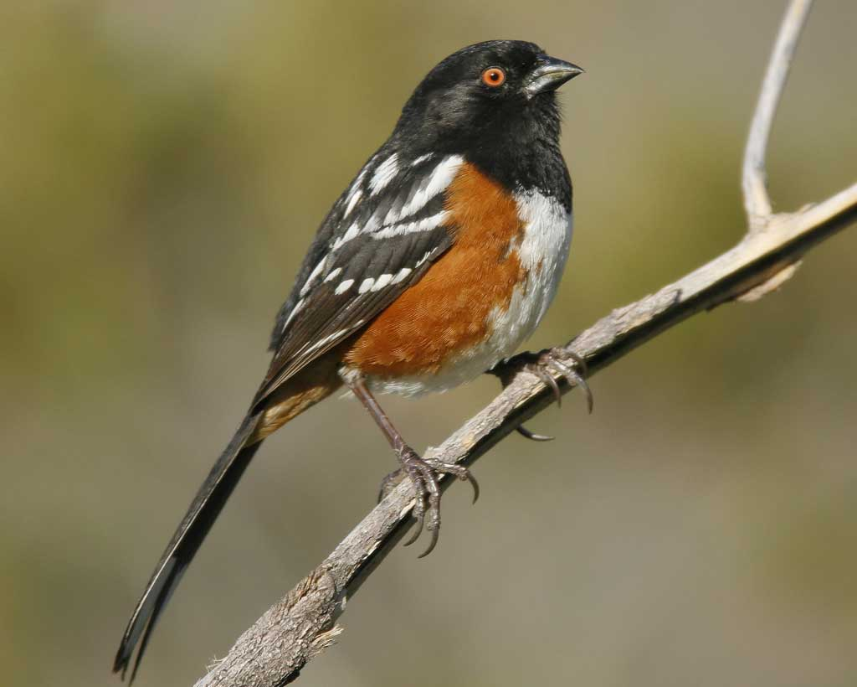
Songbirds
Study Site | Beaver Lake | Lost Lagoon | The Seawall
Abundance | No temporal trend | May be increasing or no temporal trend | No temporal trend
Richness | No temporal trend | No temporal trend | Stable
Spotted Towhee
Photo: Brian E. Small

Slide 25
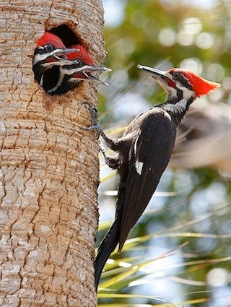
Woodpeckers
Study Site | Beaver Lake | Lost Lagoon | The Seawall
Abundance | Stable | Stable | Cannot discern
Richness | Stable | Stable | Increasing
Pileated Woodpecker
Photo: Aida Villaronga

Slide 26
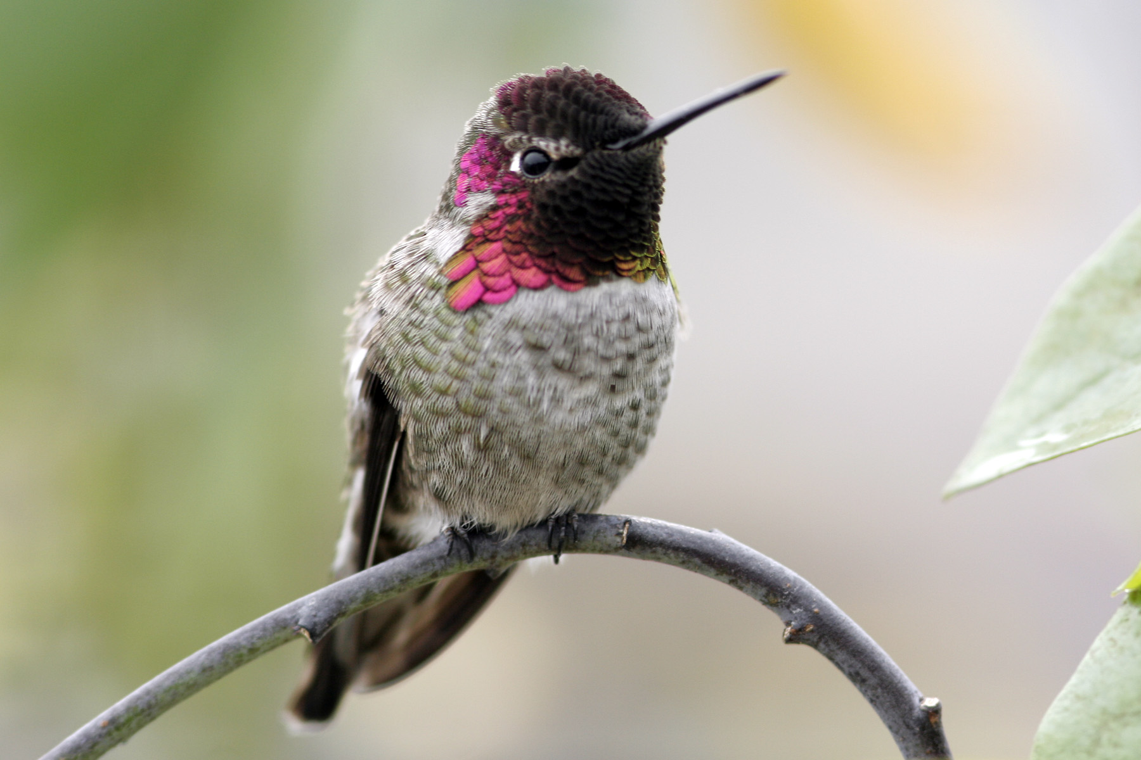
Hummingbirds
Study Site | Beaver Lake | Lost Lagoon | The Seawall
Abundance | Stable | Stable, but may be increasing | None
Richness | Stable | Stable | None
Anna`s Hummingbird
Photo: unknown

Slide 27
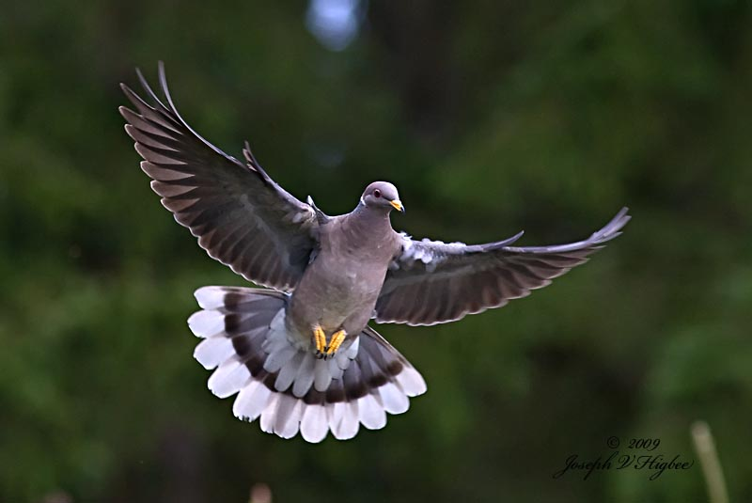
Pigeons
Study Site | Beaver Lake | Lost Lagoon | The Seawall
Abundance | Cannot discern | Decreasing | Cannot discern
Richness | Cannot discern | Stable | Stable
Band-tailed Pigeon
Photo: Joseph V. Higbee

Slide 28
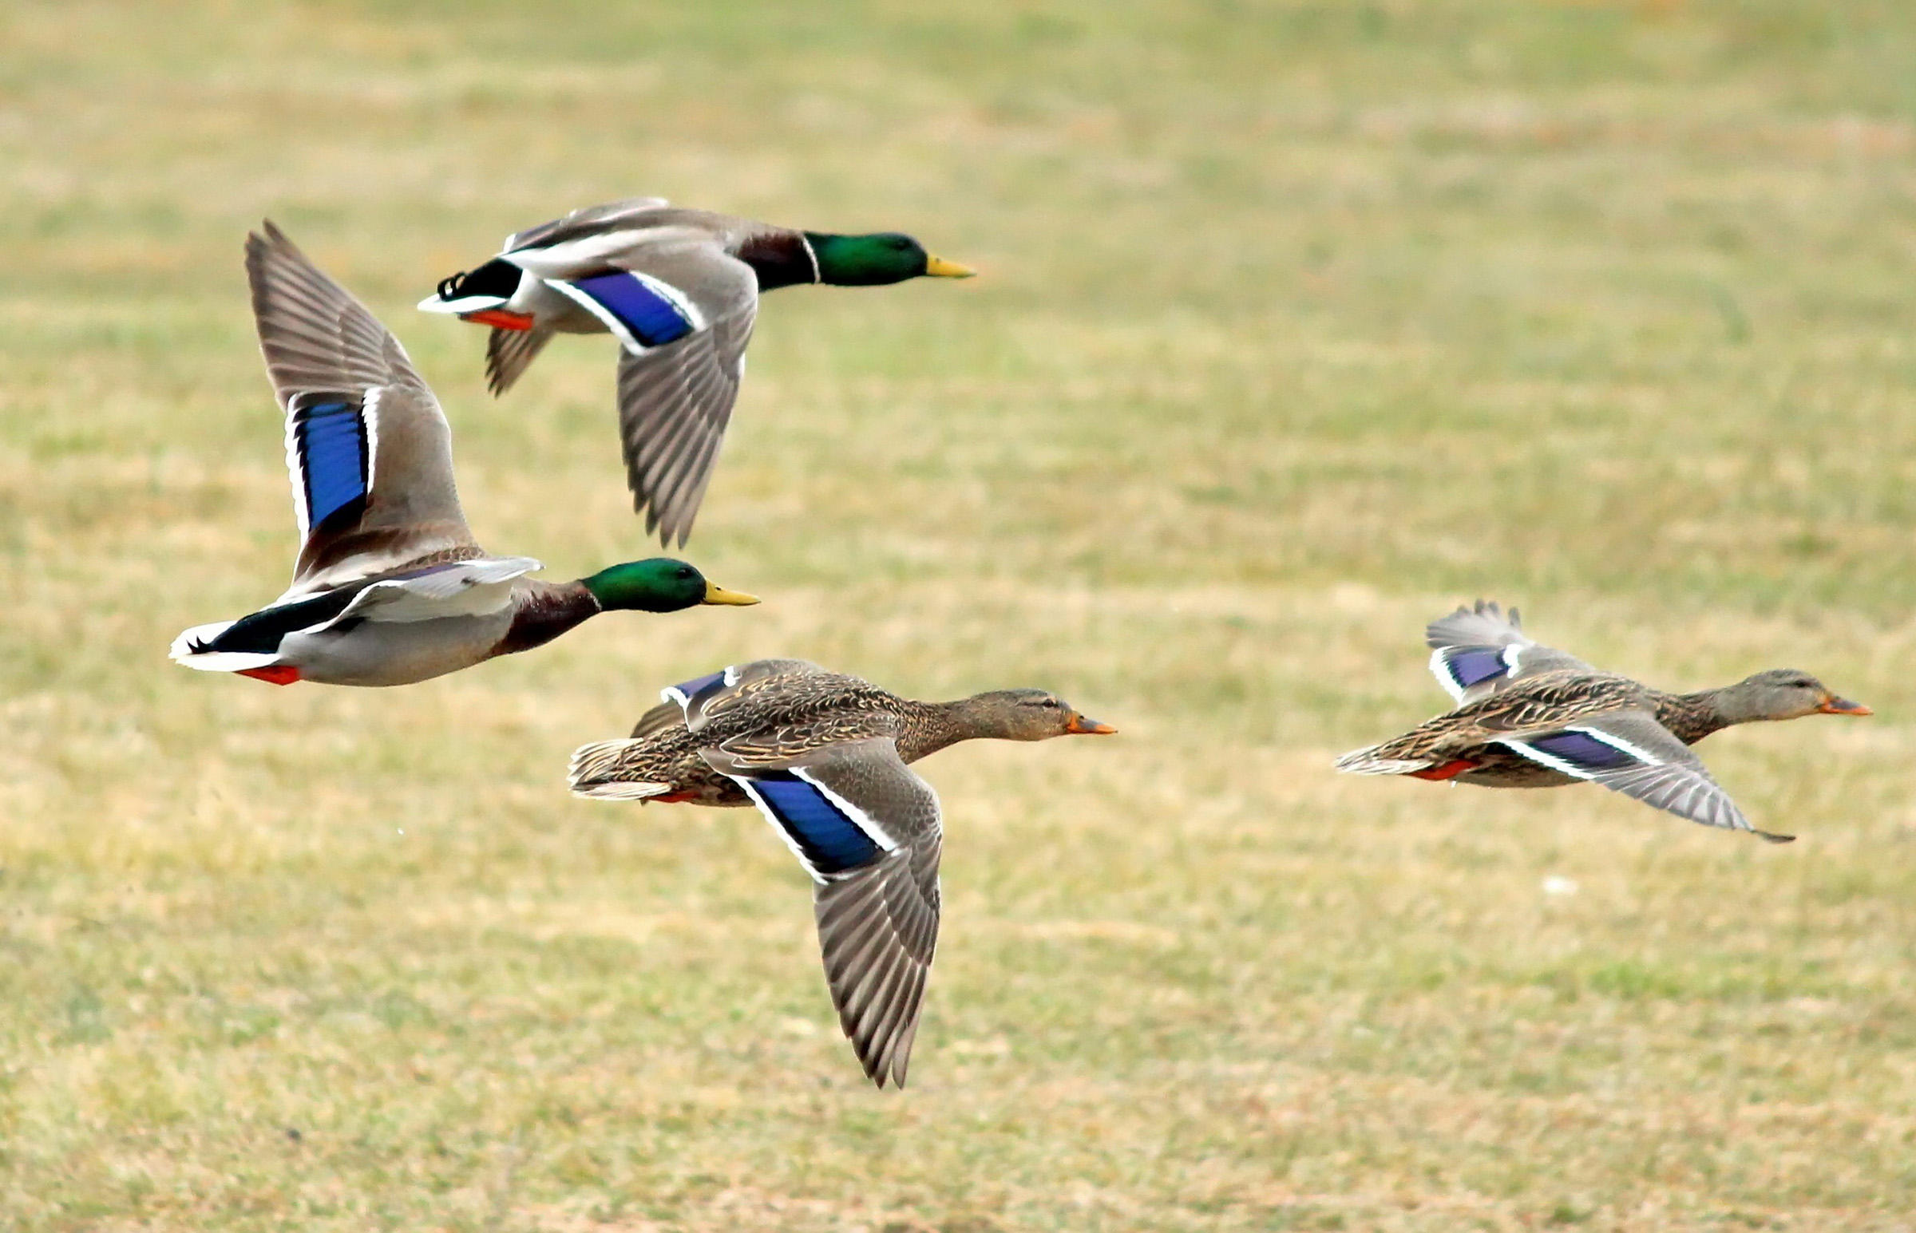
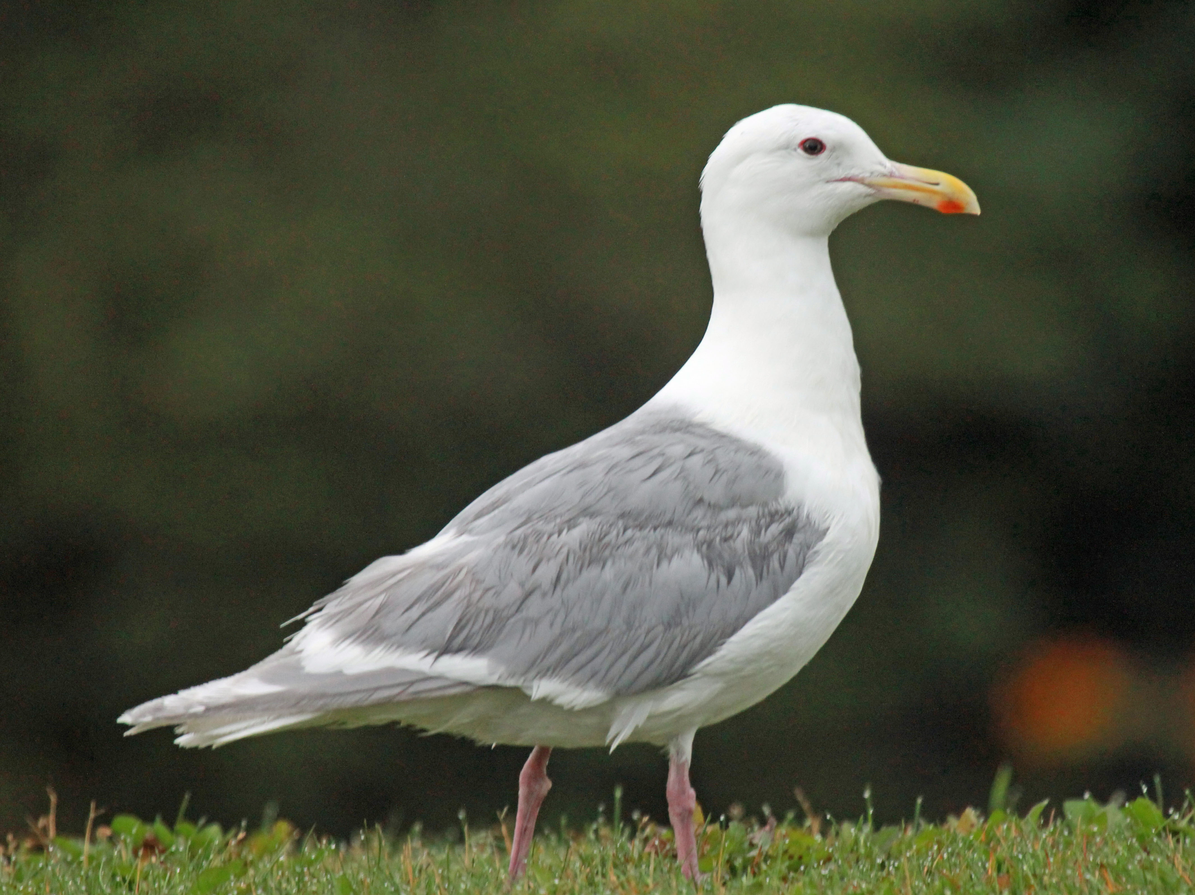
Not all disturbance-habituated species have stable/increasing biodiversity measures
Glaucous-winged Gull
Photo: DickDaniels
Mallard
Photo: Karen Bonsell
Notes:
Mallards & gulls experienced decreases.

Slide 29
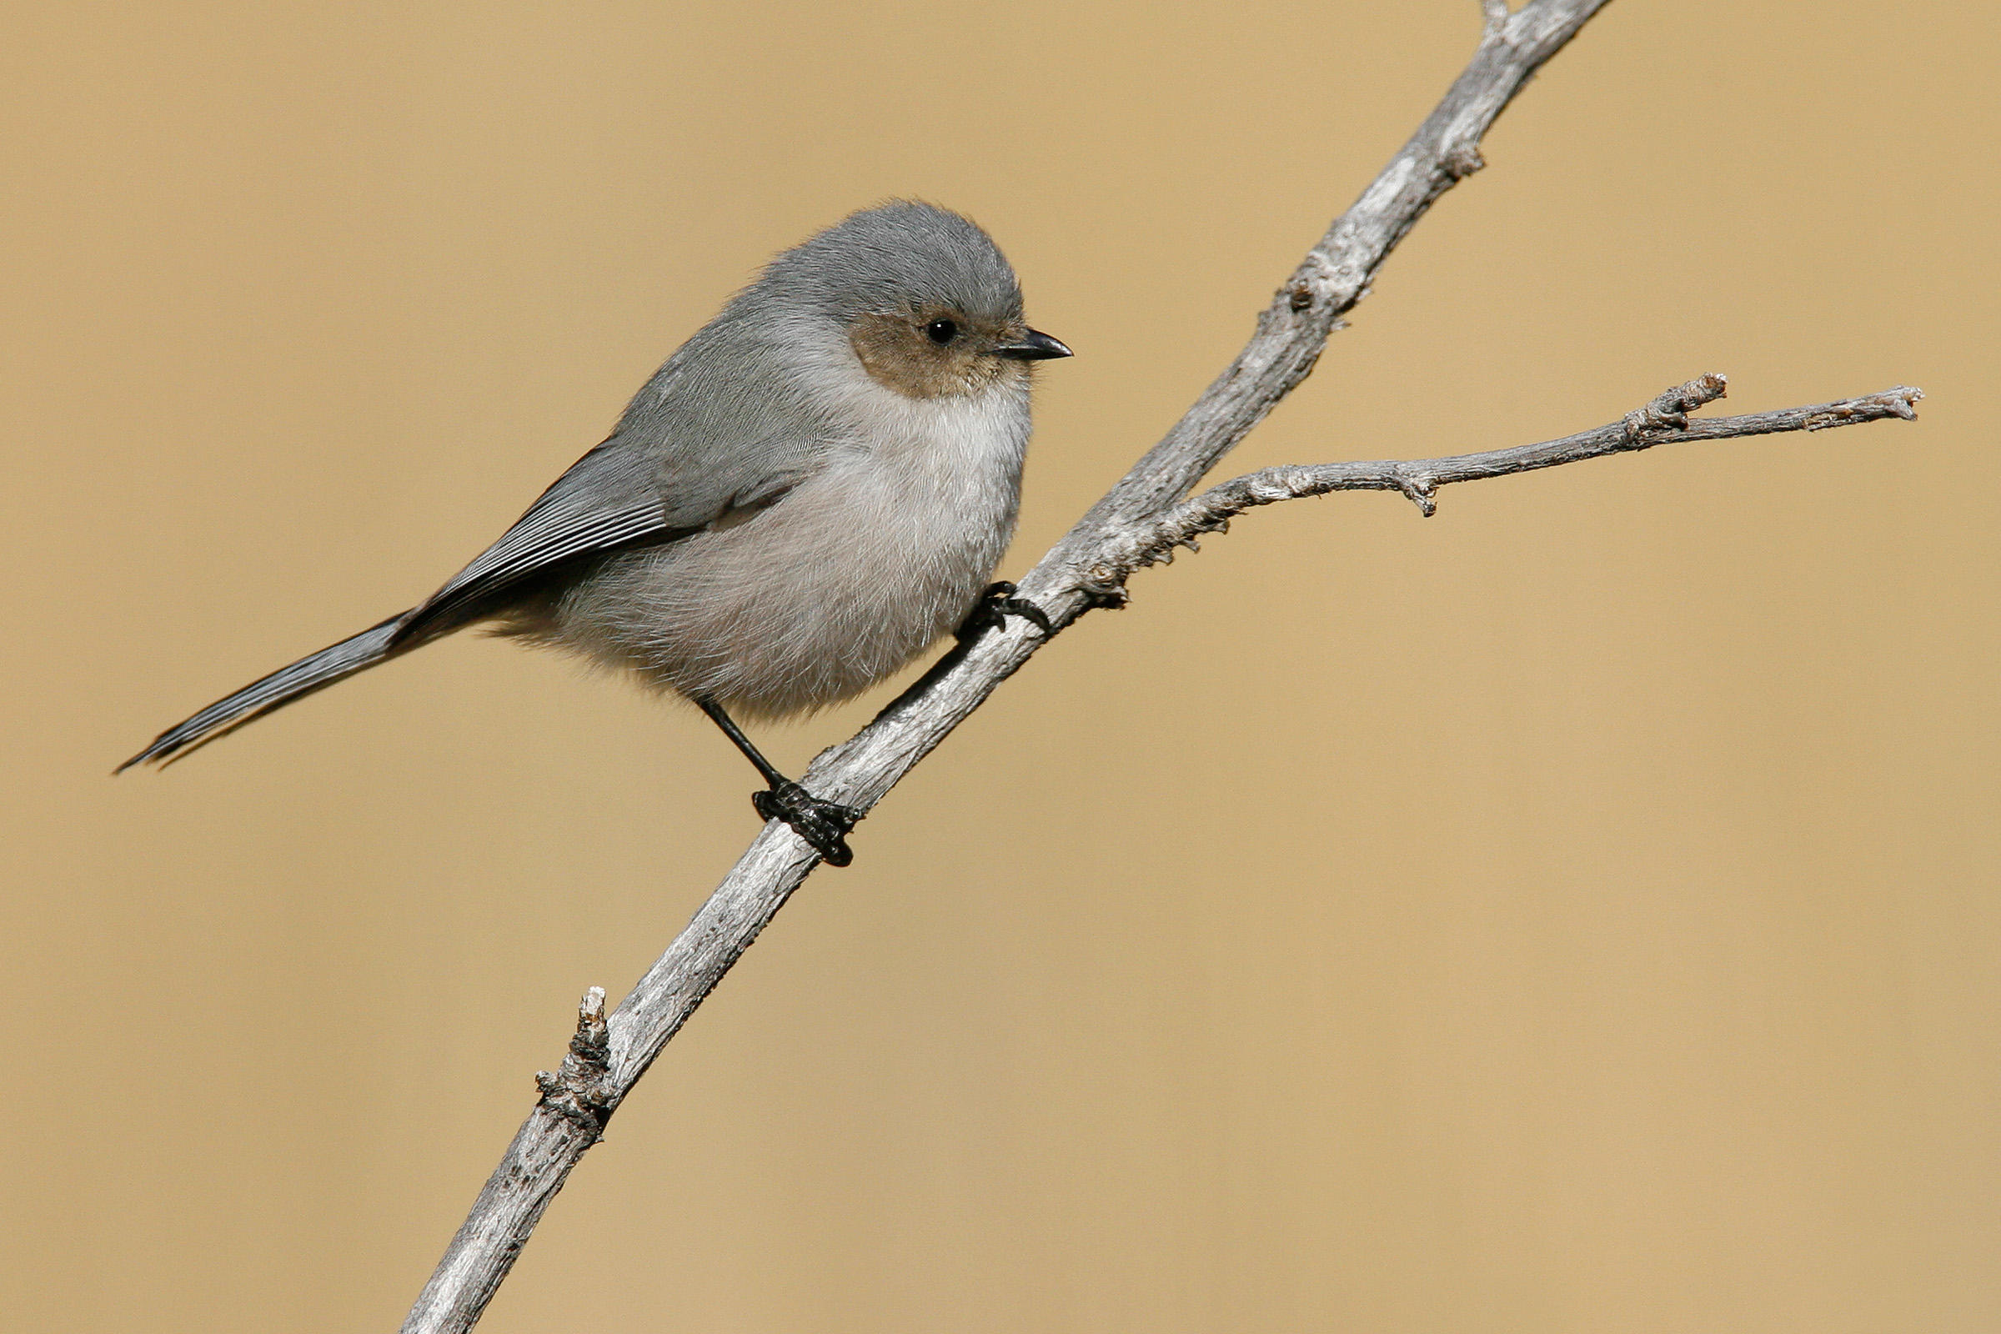
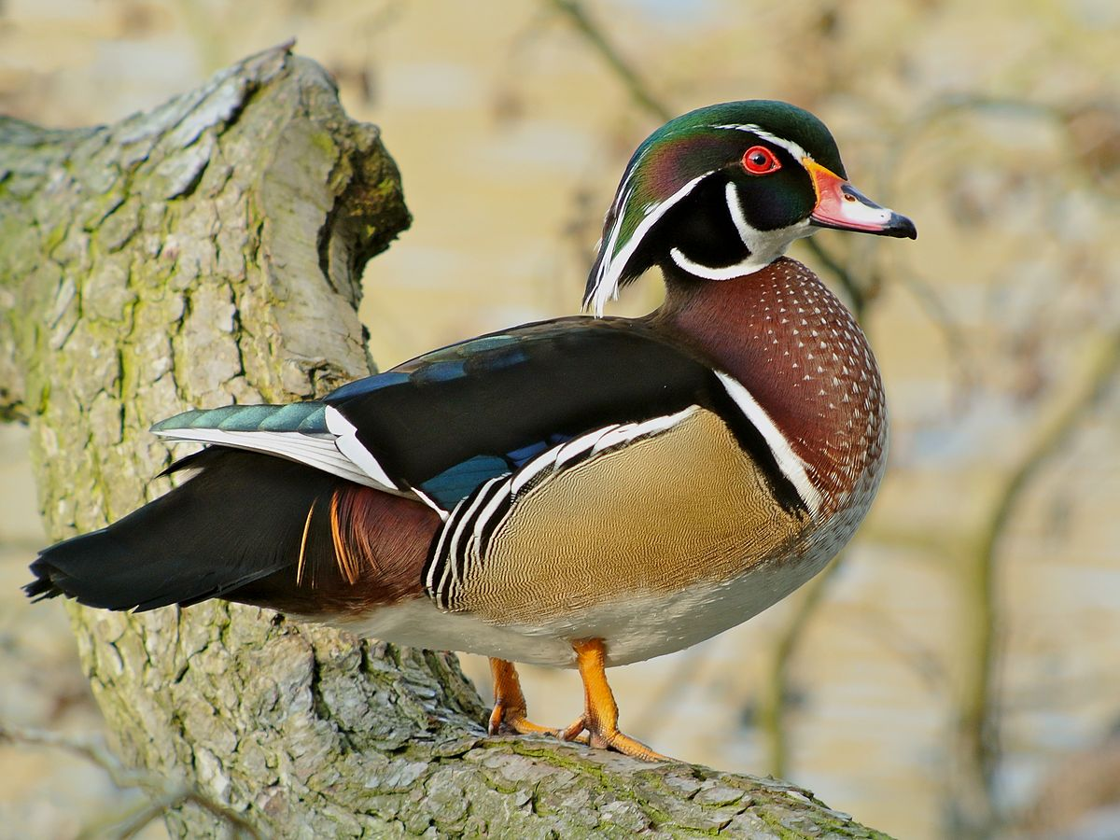
Not all less disturbance-habituated species have decreasing biodiversity measures
Wood Duck
Frank Vassen
Bushtit
Photo: Brian E. Small
Notes:
Bushtits and wood ducks had increase.

Slide 30
A previous SPES study found…
Decline in fish-eating diving bird species
Threats: industrial pollution, overfishing, habitat degradation, urban encroachment, climate change, disturbance from humans + off-leash dogs, watercraft in intertidal areas
Increase in cormorants
<= habituation to humans
Pelagic
PC: Nick + Nora Bowers
Double-Crested
PC: Laura Meyers
Brandt’s
PC: Jan Arendtsz
Prediction: Increase in population + urbanization => more disturbances => biodiversity changes
Notes:
Going back to my predictions…

Slide 31
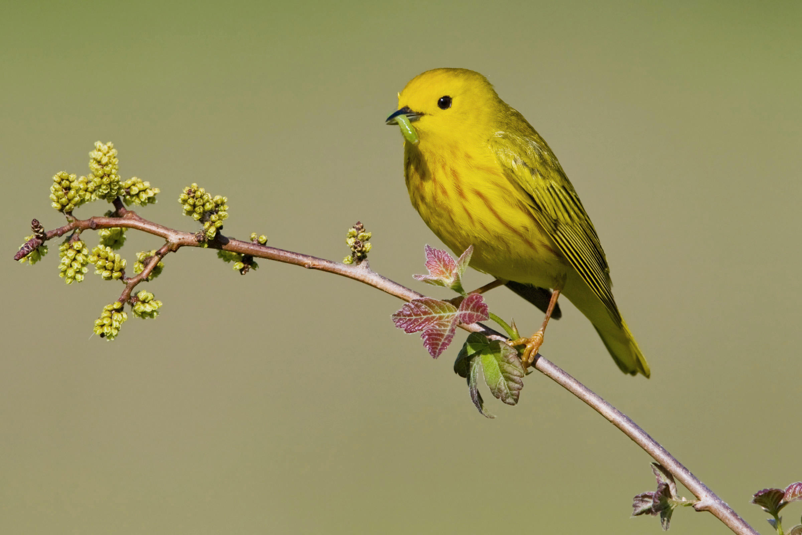
Populations are experiencing temporal trends in abundance & richness
Notes:
CONCLUSION 1
No temporal trends in diversity btw.

Slide 32
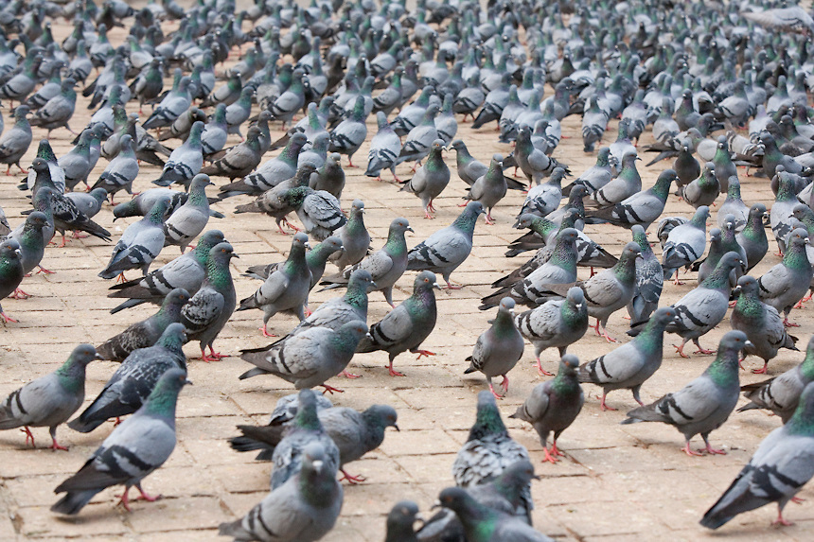
Disturbance-Adapted =/= Increasing or Stable
PC: Paul Gordon
Notes:
CONCLUSION 2

Slide 33
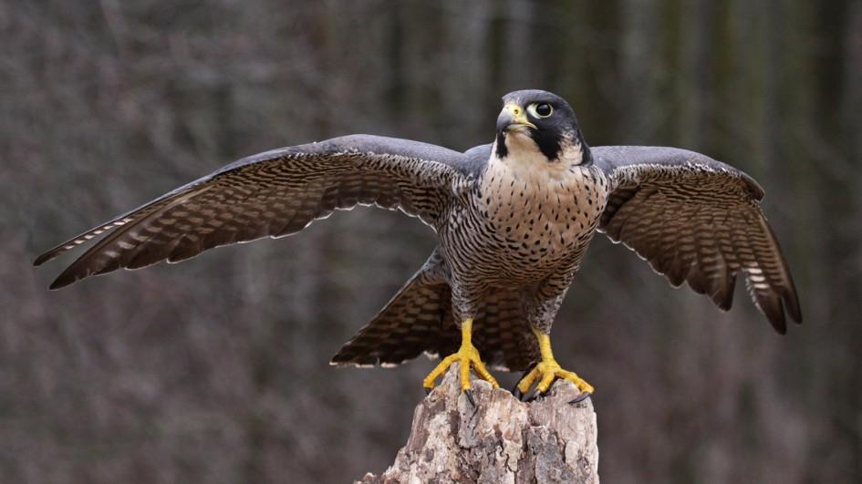
Not Disturbance-Adapted =/= Decreasing
PC: National Geographic
Notes:
CONCLUSION 3

Slide 34
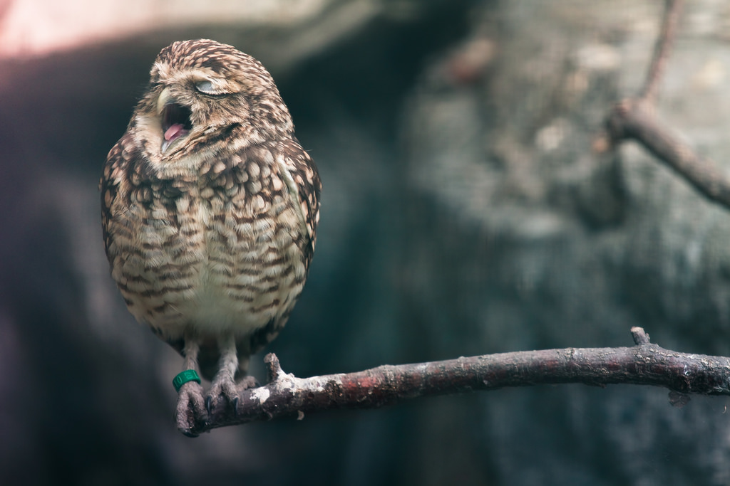
Thanks!

Slide 35
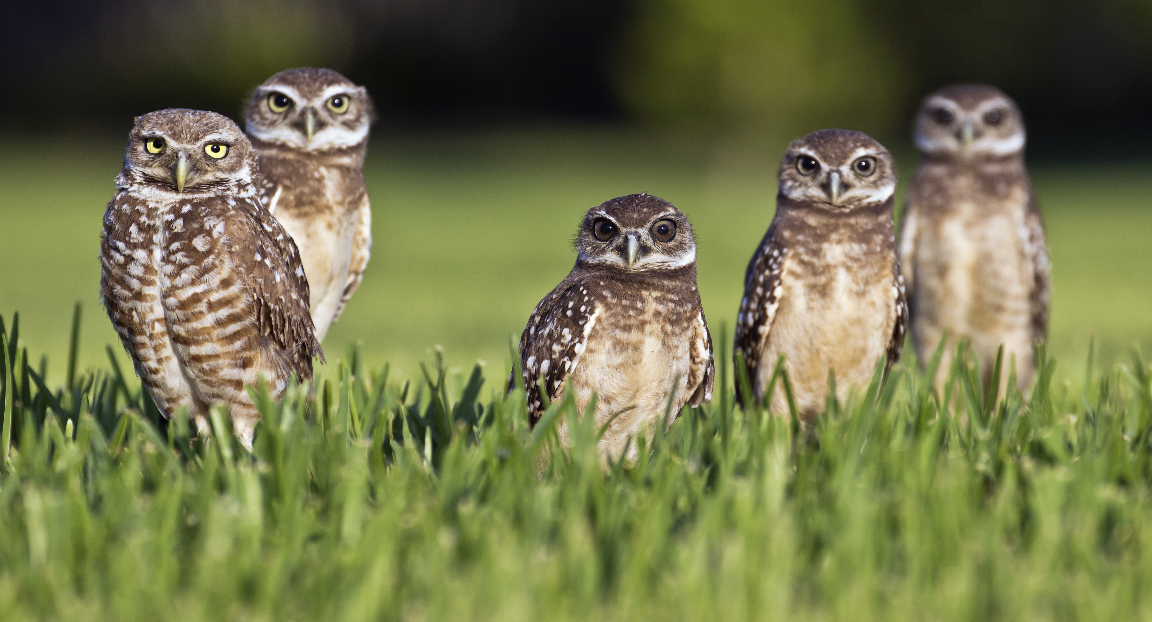
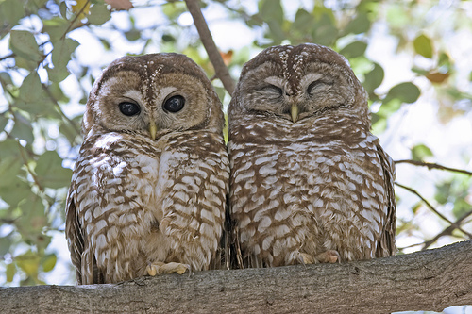
Acknowledgements
Drs. Jill Jankowski, Darren Irwin, Agnes Lacombe
Maria Egerton, Conservation Projects Manager
Vanessa Smith, Conservation Technician
Stanley Park Ecology Society & friends
Burrowing Owl
Photo: travelwayoflife
Northern Spotted Owl (very close to extinction)
Photo: unknown

Slide 36
Extra slides ahead!

Slide 37





192 Genera
236 species
30 species
72 species
10 species
Notes:
Rundown of the richness of some taxa in the park.

Slide 38

From BirdLife International
Notes:
THE FLYWAYS

Slide 39

Notes:
SoP
Started after the giant windstorm back in 2006. They wanted to get bearings on what the park’s ecological health and biodiversity was like.
Using this information, they’d be able to provide a basis for their conservation initiatives
For my Honour’s Project, I will be collaborating with the SPES on the second iteration of the SoP (or at least the bird portion of it).

Slide 40
Notes:
ALL OVER THE PLACE = I say no relationship

Slide 41


Possible explanations for decreases in biodiversity
Climate change
Air or water pollution
Disturbances
Invasive plant species
Water quality
Pink water lily (PC: Paul Colangelo)
Notes:
Air pollution = e.g. bad fumes
Water pollution = e.g. runoff from the Stanley Park Causeway
Water quality, according to the SoP: “Another factor touched upon by Worcester (2010b) is the water quality; as both Beaver Lake and Lost Lagoon are currently experiencing decreases in their depth, their chemical and physical properties may change in ways that harm local flora and fauna (e.g. increased temperature and decreased oxygen content).”

Slide 42

Possible explanations for increases in biodiversity
Stormwater treatment plant
Removing invasive species (SPES & beavers)
Dredging up the lake bottom (beavers)
Other maintenance from the SPES
Photo: Mark T. White
Notes:
Stormwater treatment plant: Finished in 2001, helps biofilter out bad things from chemical runoff coming in from the roads.
Other maintenance = e.g. replanting native species

Slide 43


Some issues with the methodology
There is no study site representing a forest
Only one survey a month
No weather record
Trends were determined by eye
No consistent set or number of birdwatchers
No randomization of start time, start location, or order

Slide 44


What now?
Conservation efforts
Removing invasive plant species
Planting native plant species
Public education
Habitat + animal monitoring

Slide 45



MALL
CAGO
DCCO
PECO
Gulls
NOCR
ROPI
EUST
HOSP
Notes:
NR = no temporal relationship
NA = Not enough data Available to make a judgement
None = NO birds from this group were seen
---------------------
NOTE: For the third tier groupings, the table shows ABUNDANCE not RICHNESS
Richness not shown because practically all groups are stable in richness
--------------
Disturbance-adapted = NOCR, ROPI, EUST, HOSP
Other birds that can be considered to have some habituation to disturbances: MALL, CAGO, DCCO, PECO, gulls
------------------
MAIN THINGS HERE TO SHOW:
Disturbance-adapted category is usually stable
Most groups are either stable or NR
A lot of species that are habituated to disturbances better than other species are actually experiencing decreases.
i.e. all the species that I mentioned have experienced decreases. These end up causing their associated second and third tier groups to show decreases.
In fact, the only group where decreases aren’t linked to any disturbance habituated birds is the Rallidae.

Slide 46

Biodiversity changes have sociological effects
Decrease biodiversity => fewer opportunities to learn from and appreciate extinct species (Chapin III et al. 2000)
Degree of avian biodiversity experienced proportional to appreciation of nature (Clergeau et al. 2001)
Problem: Humans living in an urban setting have a high chance of experiencing biological poverty (Melles 2005)
Northern
Spotted Owl
( A few in BC)
Photo: Robin Loznak
Photo: Unknown
Notes:
Extinct species: NORTHERN SPOTTED OWL HAS LIKE 11 LEFT IN BC. They go extinct => you won’t see their beauty ahhhhhhhhhh
Clergeau et al: asked questions like ‘Have you seen birds in neighbourhood”, ‘Do you observe them”, “Can you identify indiv species”, “Do you try to id them”, “describe them as tame/domestic/wild”, “Do you feed birds”, “Birds disturb/please/both”.
Asked them how much they hated common species (starling, herring gull, house sparrow, rock dove)
Biological poverty: Seeing below-average levels of native species biodiversity (Turner et al. 2004)

